Slide 1

Joint Models for NLP
Yue Zhang
Westlake Institute for Advanced Study

Slide 2
Outline
Motivation
Statistical Models
Deep Learning Models

Slide 3
Outline
Motivation
Statistical Models
Deep Learning Models

Slide 4
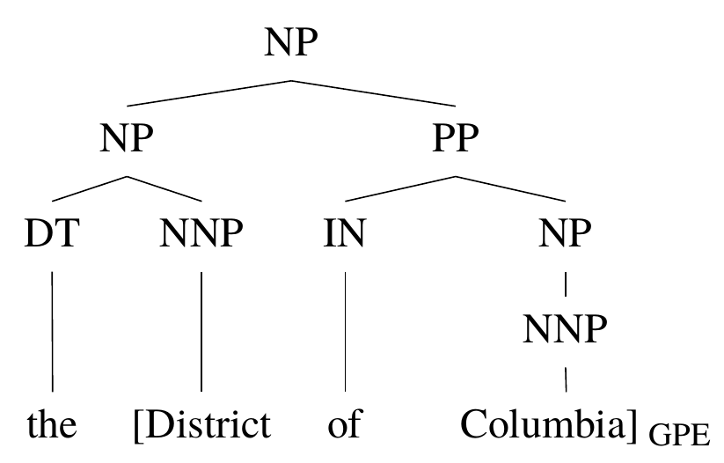
Motivation
Related tasks in NLP
Constituents and named entities

Slide 5
Motivation
Related tasks in NLP
NER, Chunking and POS Tagging
Sentence:
POS Tagging:
NER:
Chunking:
Joi | runs | the | MIT | Media | Lab | .
NNP | VBZ | DT | NNP | NNP | NNP | .
PER | O | O | B-ORG | I-ORG | I-ORG | O
S | S | S | B | I | E | O

Slide 6
Motivation
Pipelines in NLP
Segmentation POS tagging
布朗访问上海
布朗/ 访问/ 上海/
布朗/NR 访问/VV 上海/NR

Slide 7
Motivation
Pipelines in NLP
Entity and Relation
sentence
Associated Press writer Patrick McDowell in Kuwait City
NER
Associated Press
writer
Patrick McDowell
in
Kuwait City
ORG
PER
GPE
ORG-AFF
PHYS
RELATION
Associated Press
writer
Patrick McDowell
in
Kuwait City
ORG
PER
GPE

Slide 8
Motivation
Pipelines in NLP
Entity and Sentiment
sentence
So excited to meet my baby Farah !!!
NER
So excited to meet my [baby Farah] !!!
PER
Sentiment
So excited to meet my [baby Farah]+ !!!
PER + POSITIVE

Slide 9
Motivation
Joint model
Reduce error propagation
Allow information exchange between tasks
Challenge
Joint learning
Search

Slide 10
Solutions
Covered by this talk
Learning
 | Joint | Separate
Joint | Statistical Neural | Statistical
Separate | Neural
Search

Slide 11
Outline
Motivation
Statistical Models
Deep Learning Models

Slide 12
Statistical Models
Graph-Based Methods
Transition-Based Methods

Slide 13
Statistical Models
Graph-Based Methods
Transition-Based Methods

Slide 14
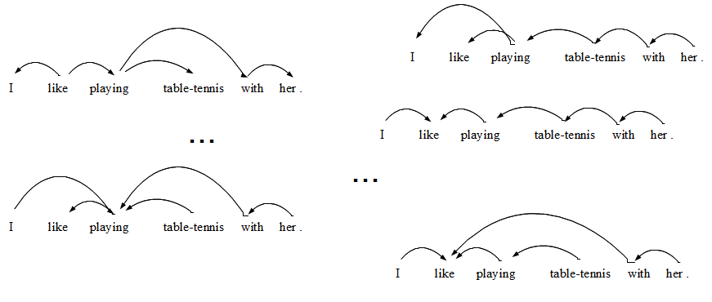
Graph-Based Methods
Traditional solution
Score each candidate, select the highest-scored output
Search-space typically exponential
Over 100 possible trees for this seven-word sentence.
Over one million trees for a 20-word sentence.

Slide 15
Graph-Based Methods
Joint Label Structure
Reranking
Joint Modeling (Multi task)
Joint Modeling (Single task)

Slide 16
Graph-Based Methods
Joint Label Structure
Reranking
Joint Modeling (Multi task)
Joint Modeling (Single task)

Slide 17
Graph-Based Methods
Joint Label Structure
Reranking
Joint Modeling (Multi task)
Joint Modeling (Single task)
Joint Search
,
Joint Learning

Slide 18
Joint Segmentation and POS tagging
Tasks
POS
Tagger
Words
Segmenter
Characters
Input

Slide 19
Joint Segmentation and POS tagging
Traditional pipeline
Segmentation
布朗 访问 上海
NN VV NN
POS Tagging
Ng, Hwee Tou, and Jin Kiat Low. "Chinese part-of-speech tagging: One-at-a-time or all-at-once? word-based or character-based?." EMNLP. 2004.

Slide 20
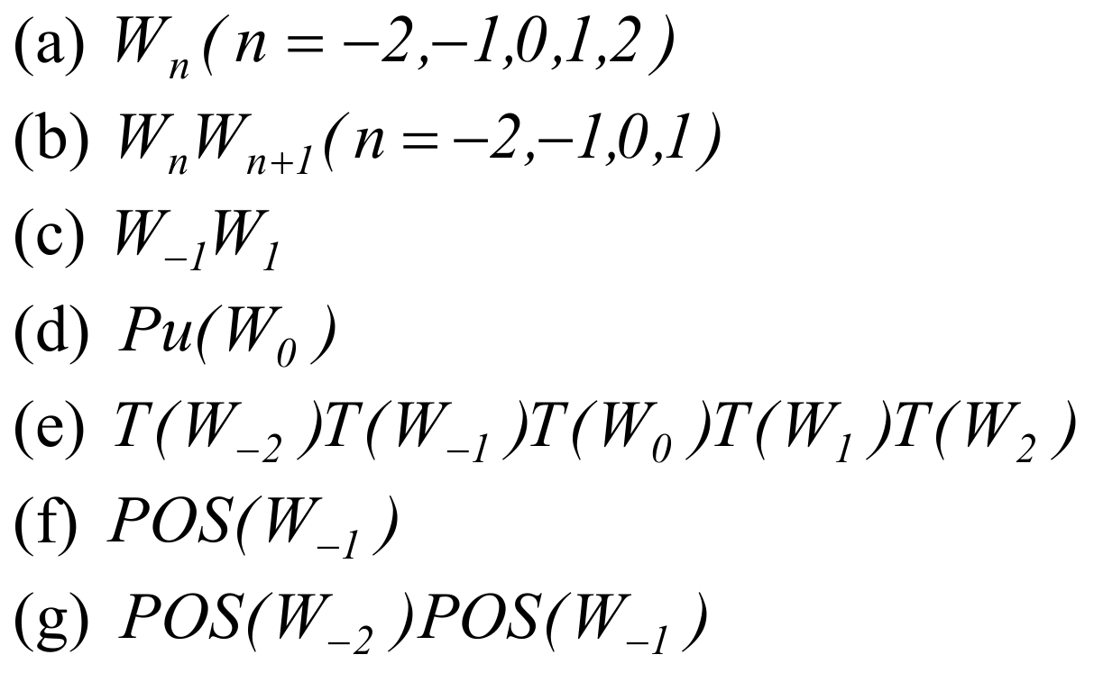
Joint Segmentation and POS tagging
One-at-a-Time, Word-Based POS Tagger : Feature
Ng, Hwee Tou, and Jin Kiat Low. "Chinese part-of-speech tagging: One-at-a-time or all-at-once? word-based or character-based?." EMNLP. 2004.

Slide 21
Joint Segmentation and POS tagging
Collapsing labels
BE BE BE
布朗 访问 上海
NN VV NN
B-NN E-NN B-VV E-VV B-NN E-NN
布 朗 访 问 上 海
Ng, Hwee Tou, and Jin Kiat Low. "Chinese part-of-speech tagging: One-at-a-time or all-at-once? word-based or character-based?." EMNLP. 2004.

Slide 22
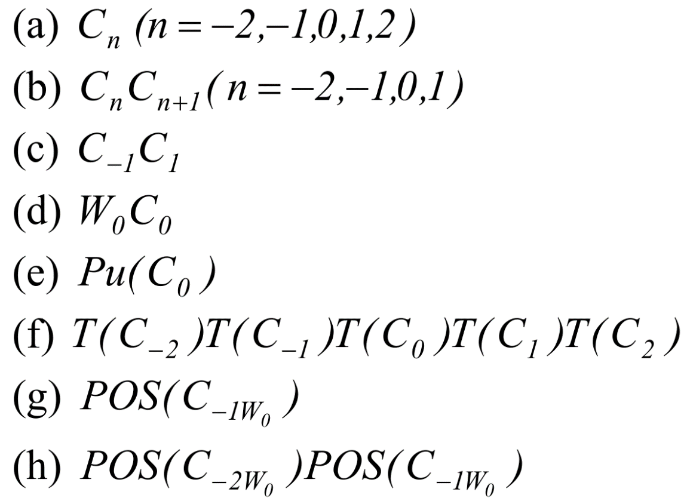
Joint Segmentation and POS tagging
One-at-a-Time, Character-Based POS Tagger : Feature
Ng, Hwee Tou, and Jin Kiat Low. "Chinese part-of-speech tagging: One-at-a-time or all-at-once? word-based or character-based?." EMNLP. 2004.

Slide 23
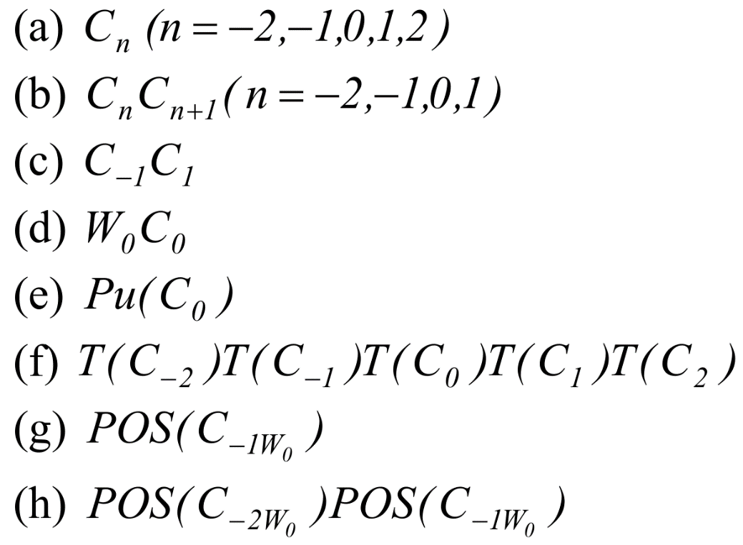
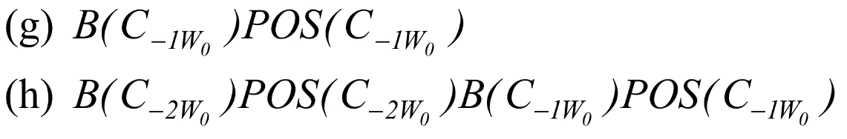
Joint Segmentation and POS tagging
All-at-Once, Character-Based POS Tagger and Segmenter : Feature
Ng, Hwee Tou, and Jin Kiat Low. "Chinese part-of-speech tagging: One-at-a-time or all-at-once? word-based or character-based?." EMNLP. 2004.

Slide 24
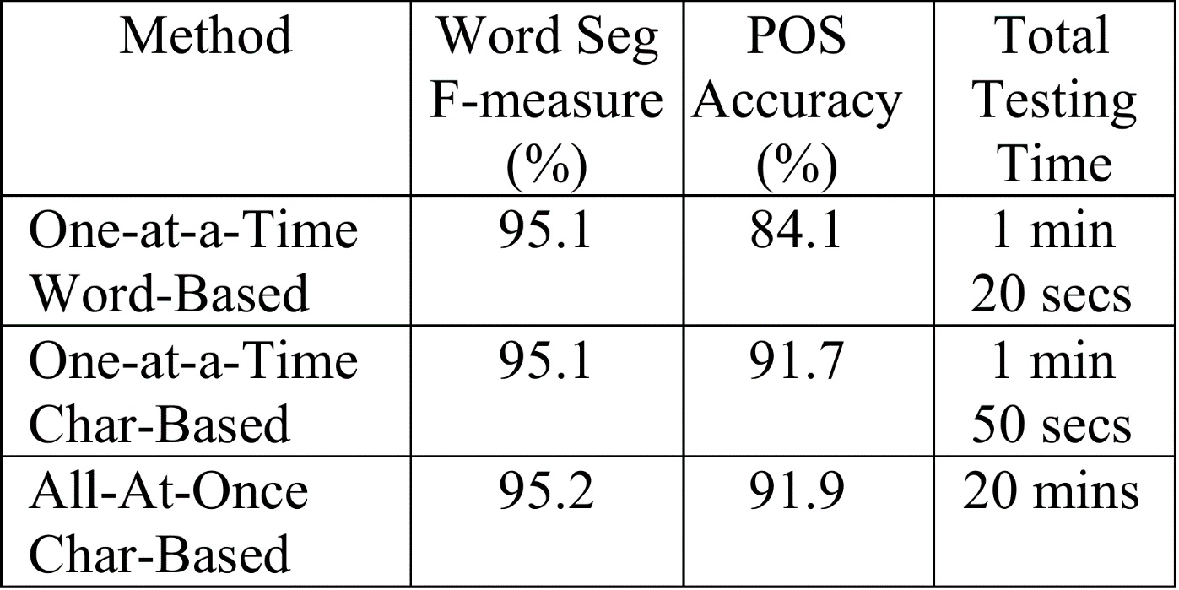
Joint Segmentation and POS tagging
Results on CTB
Ng, Hwee Tou, and Jin Kiat Low. "Chinese part-of-speech tagging: One-at-a-time or all-at-once? word-based or character-based?." EMNLP. 2004.

Slide 25
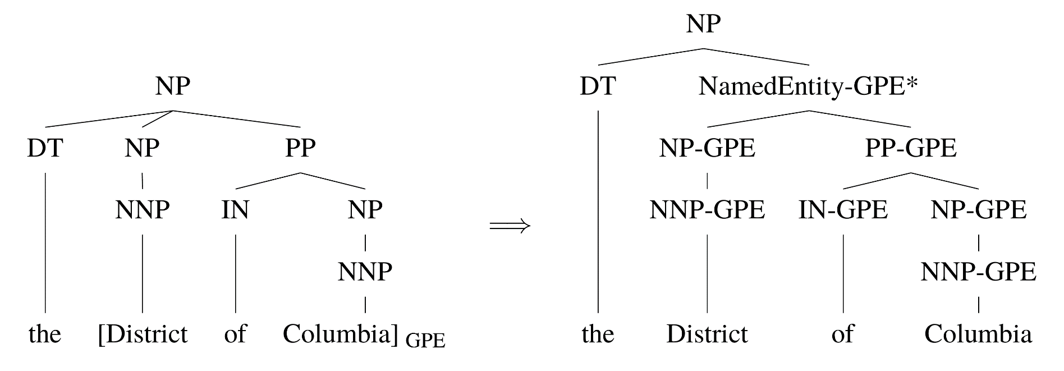
Joint Parsing and NER
A joint model of both parsing and named entity recognition.
Finkel, Jenny Rose, and Christopher D. Manning. "Joint parsing and named entity recognition." Proceedings of Human Language Technologies: The 2009 Annual Conference of the North American Chapter of the Association for Computational Linguistics. Association for Computational Linguistics, 2009.

Slide 26
Joint Parsing and NER
A feature-based CRF-CFG parser operating over tree structures augmented with NER information.
Finkel, Jenny Rose, and Christopher D. Manning. "Joint parsing and named entity recognition." Proceedings of Human Language Technologies: The 2009 Annual Conference of the North American Chapter of the Association for Computational Linguistics. Association for Computational Linguistics, 2009.

Slide 27
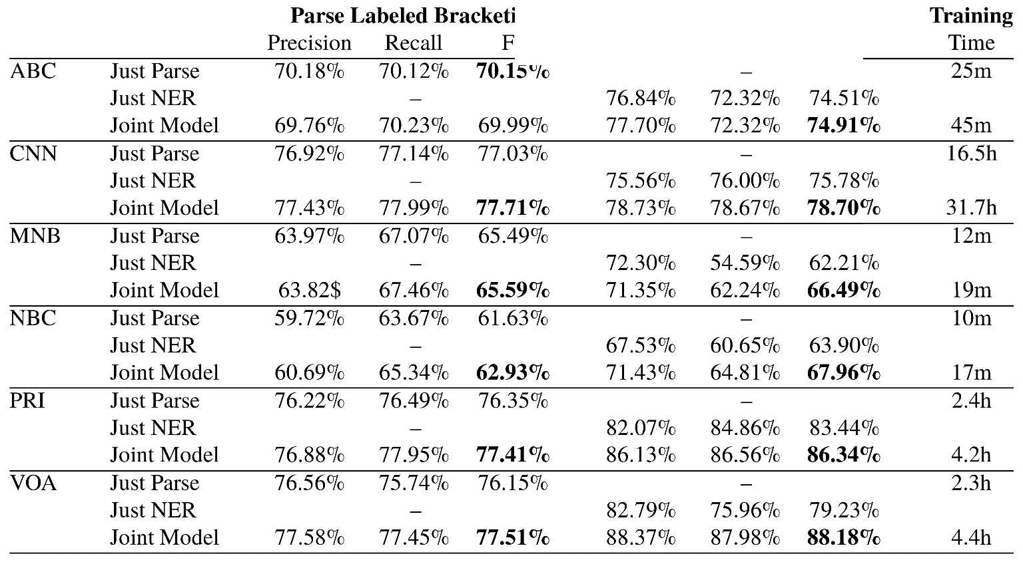
Joint Parsing and NER
Results on OntoNotes
Finkel, Jenny Rose, and Christopher D. Manning. "Joint parsing and named entity recognition." Proceedings of Human Language Technologies: The 2009 Annual Conference of the North American Chapter of the Association for Computational Linguistics. Association for Computational Linguistics, 2009.

Slide 28
Graph-Based Methods
Joint Label Structure
Reranking
Joint Modeling (Multi task)
Joint Modeling (Single task)

Slide 29
Graph-Based Methods
Joint Label Structure
Reranking
Joint Modeling (Multi task)
Joint Modeling (Single task)
Joint Search
,
Separate Learning

Slide 30
Joint Segmentation and POS Tagging
Conditional Random Field(CRF) models for both Segmentation and POS Tagging .
Separately trained, reranking.
Use tag sequence score to rank segmentation.
Shi, Yanxin, and Mengqiu Wang. "A Dual-layer CRFs Based Joint Decoding Method for Cascaded Segmentation and Labeling Tasks." IJcAI. 2007.

Slide 31
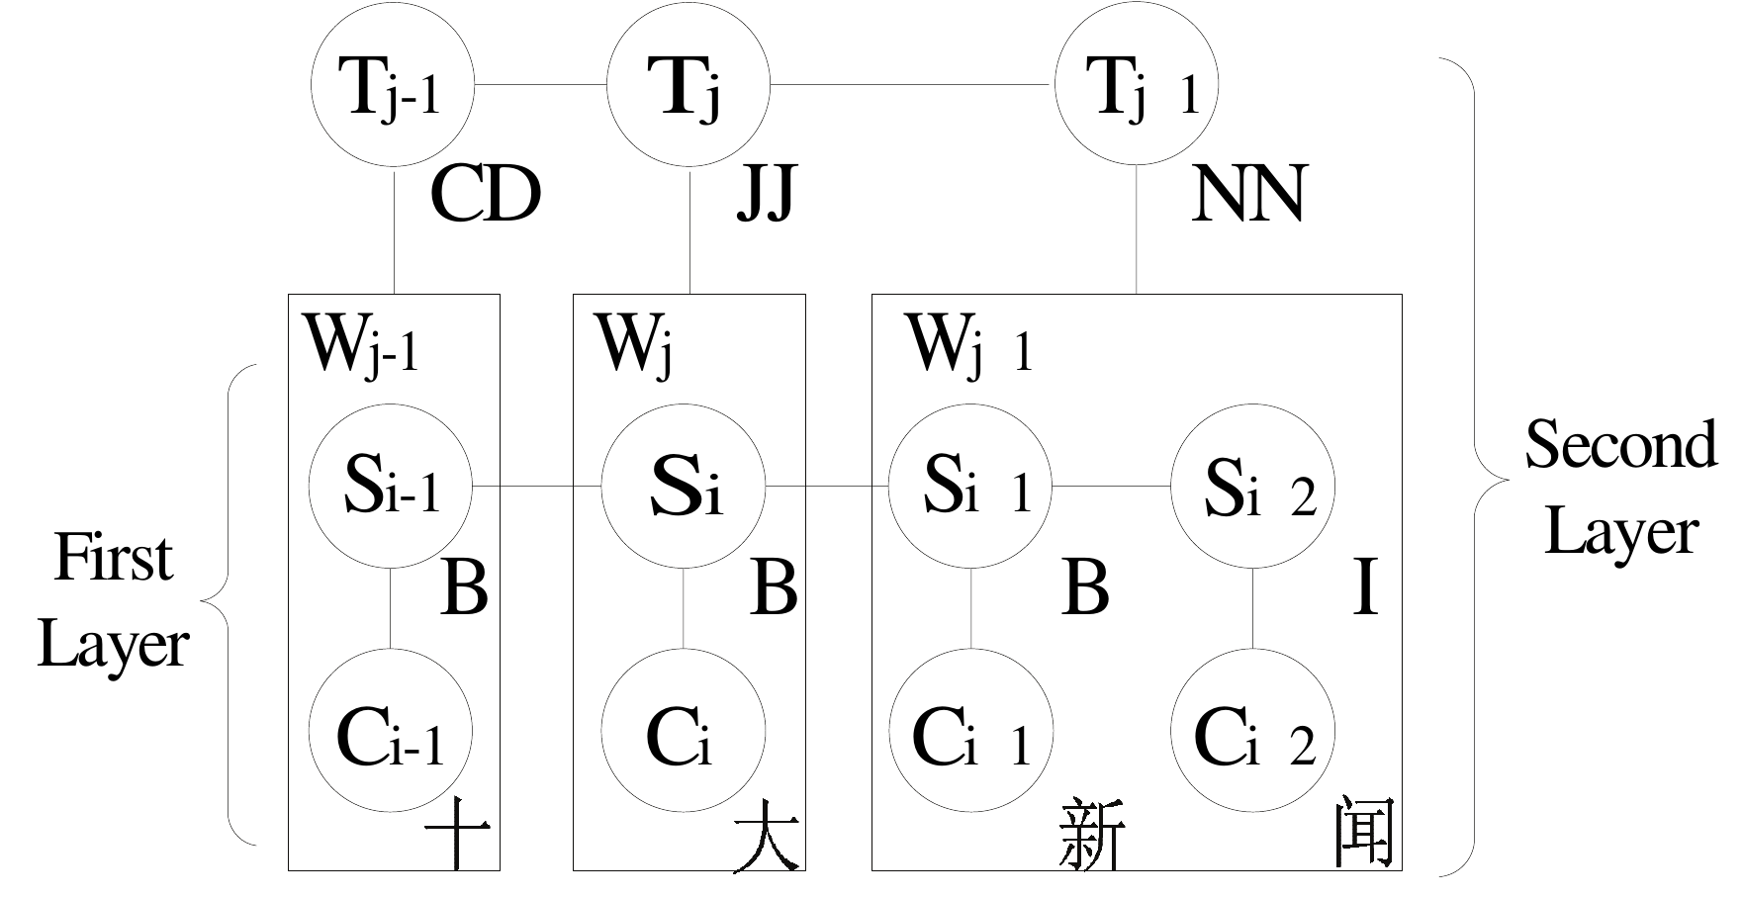
Joint Segmentation and POS Tagging
Dual-layer CRFs
Shi, Yanxin, and Mengqiu Wang. "A Dual-layer CRFs Based Joint Decoding Method for Cascaded Segmentation and Labeling Tasks." IJcAI. 2007.

Slide 32
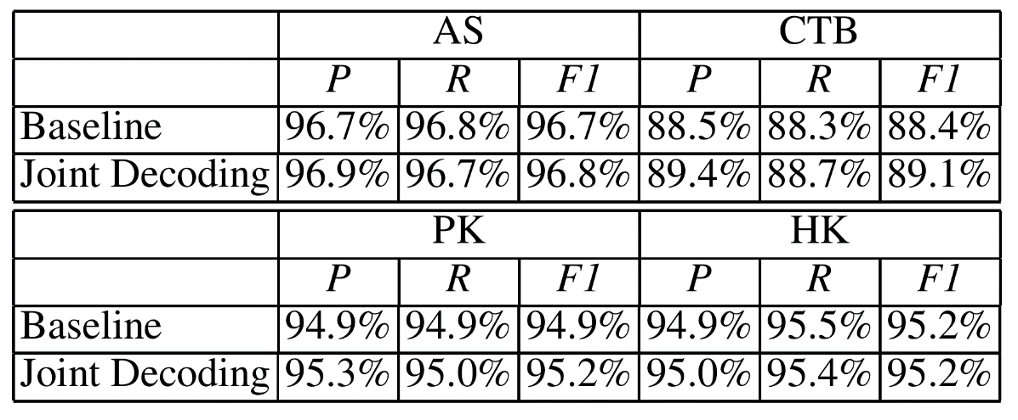
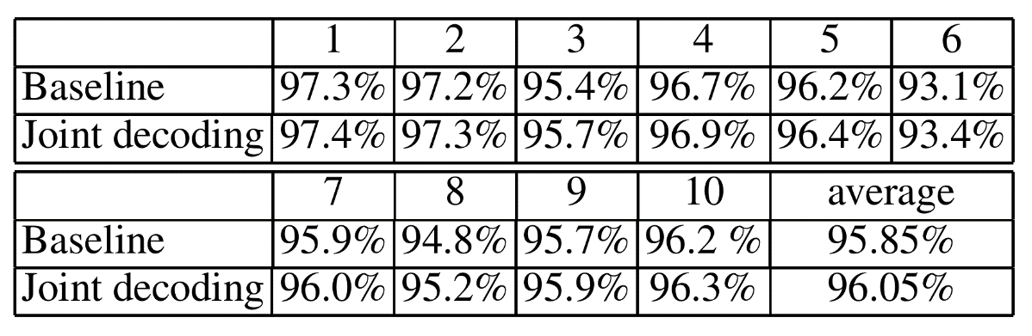
Joint Segmentation and POS Tagging
Results for Segmentation
Shi, Yanxin, and Mengqiu Wang. "A Dual-layer CRFs Based Joint Decoding Method for Cascaded Segmentation and Labeling Tasks." IJcAI. 2007.

Slide 33
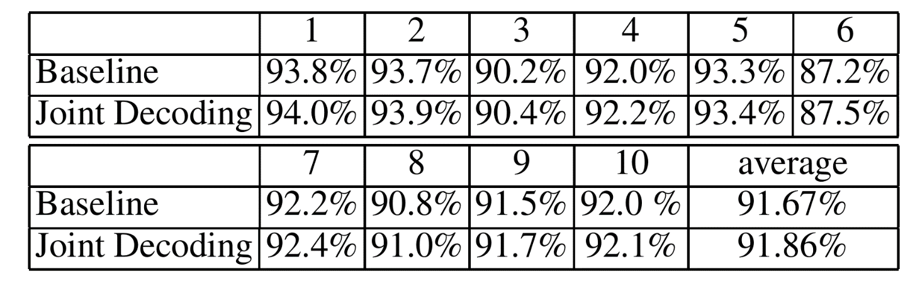
Joint Segmentation and POS Tagging
Results for POS Tagging
Shi, Yanxin, and Mengqiu Wang. "A Dual-layer CRFs Based Joint Decoding Method for Cascaded Segmentation and Labeling Tasks." IJcAI. 2007.

Slide 34
Joint Parsing and SRL
Task
Semantic Roles
SRL
Syntax
Parser
Input
Sutton, Charles, and Andrew McCallum. "Joint parsing and semantic role labeling." Proceedings of the Ninth Conference on Computational Natural Language Learning. Association for Computational Linguistics, 2005.

Slide 35
Joint Parsing and SRL
The goal: narrow the gap between SRL results from gold parses and from automatic parses.
aims to achieve this by jointly performing parsing and semantic role labeling in a single probabilistic model.
This paper rerank the k-best parse trees from a probabilistic parser using an SRL system.
Sutton, Charles, and Andrew McCallum. "Joint parsing and semantic role labeling." Proceedings of the Ninth Conference on Computational Natural Language Learning. Association for Computational Linguistics, 2005.

Slide 36
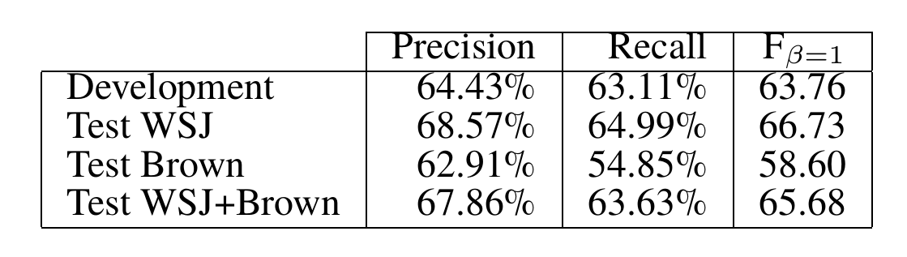
Joint Parsing and SRL
Results on CoNLL
Did not beat a pipeline baseline
Many subsequent CoNLL shared tasks show difficulties for this joint task
Sutton, Charles, and Andrew McCallum. "Joint parsing and semantic role labeling." Proceedings of the Ninth Conference on Computational Natural Language Learning. Association for Computational Linguistics, 2005.

Slide 37
Graph-Based Methods
Joint Label Structure
Reranking
Joint Modeling (Multi task)
Joint Modeling (Single task)

Slide 38
Graph-Based Methods
Joint Label Structure
Reranking
Joint Modeling (Multi task)
Joint Modeling (Single task)
Joint Search
,
Separate Learning

Slide 39
Joint Modeling
Joint Search, separate training
Search complex problem
ILP
BP
Dual Decomposition
Auli, Michael, and Adam Lopez. "A comparison of loopy belief propagation and dual decomposition for integrated CCG supertagging and parsing." Proceedings of the 49th Annual Meeting of the Association for Computational Linguistics: Human Language Technologies-Volume 1. Association for Computational Linguistics, 2011.

Slide 40
Joint Entity and Sentiment
Opinion linking relations
The numberic subscripts denote linking relations, one of IS-ABOUT OR IS-FROM
Opinion entities:
Opinion expressions: O
Opinion targets: T
Opinion holders: H
jointly identifies opinion-related entities, as well as opinion linking relations
[The workers]_{[H1,2]} were irked _{[O1]} by [the government report]_{[T1]} and were worried_{[O2]} as they went about their daily chores.
Yang, Bishan, and Claire Cardie. "Joint Inference for Fine-grained Opinion Extraction." ACL (1). 2013.

Slide 41
Joint Entity and Sentiment
Model
Opinion entity identification: sequence labeling using conditional random fields (CRFs);
Relation extraction: binary classification using L1-regularized logistic regression;
Optimize the joint objective function which is defined as a linear combination of the potentials from different predictors with a parameter λ to balance the contribution of these two components: opinion entity identification and opinion relation extraction.
Yang, Bishan, and Claire Cardie. "Joint Inference for Fine-grained Opinion Extraction." ACL (1). 2013.

Slide 42
Joint Entity and Sentiment
CRF for Opinion Entity Identification
t₁
t₂
……
t_{n}
w₁
w₂
……
w_{n}
D – Opinion expression
T – Opinion target
H – Opinion Holder
N – Opinion None
Yang, Bishan, and Claire Cardie. "Joint Inference for Fine-grained Opinion Extraction." ACL (1). 2013.

Slide 43
Joint Entity and Sentiment
Relation Extraction
A classification model for opinion target relation
A classification model for opinion holder relation
Syntactic and semantic features are used
Yang, Bishan, and Claire Cardie. "Joint Inference for Fine-grained Opinion Extraction." ACL (1). 2013.

Slide 44
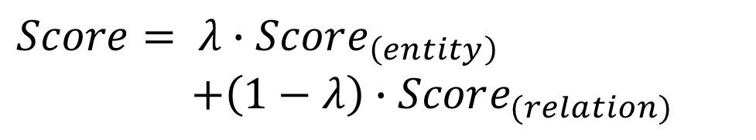
Joint Entity and Sentiment
Joint scoring function by linearposition
$$Score= λ∙Score_{\left(entity\right)}$$
$+\left(1−λ\right)∙Score_{(relation)}$
Yang, Bishan, and Claire Cardie. "Joint Inference for Fine-grained Opinion Extraction." ACL (1). 2013.

Slide 45
Joint Entity and Sentiment
ILP for search
Constraint 1: Uniqueness
Constraint 2: Non-overlapping
Constraint 3: Consistency between the opinion-arg and opinion-implicit-arg classifiers
Constraint 4: Consistency between opinion-arg classifier and opinion entity extractor
Constraint 5: Consistency between the opinion-implicit-arg classifier and opinion entity extractor
Yang, Bishan, and Claire Cardie. "Joint Inference for Fine-grained Opinion Extraction." ACL (1). 2013.

Slide 46
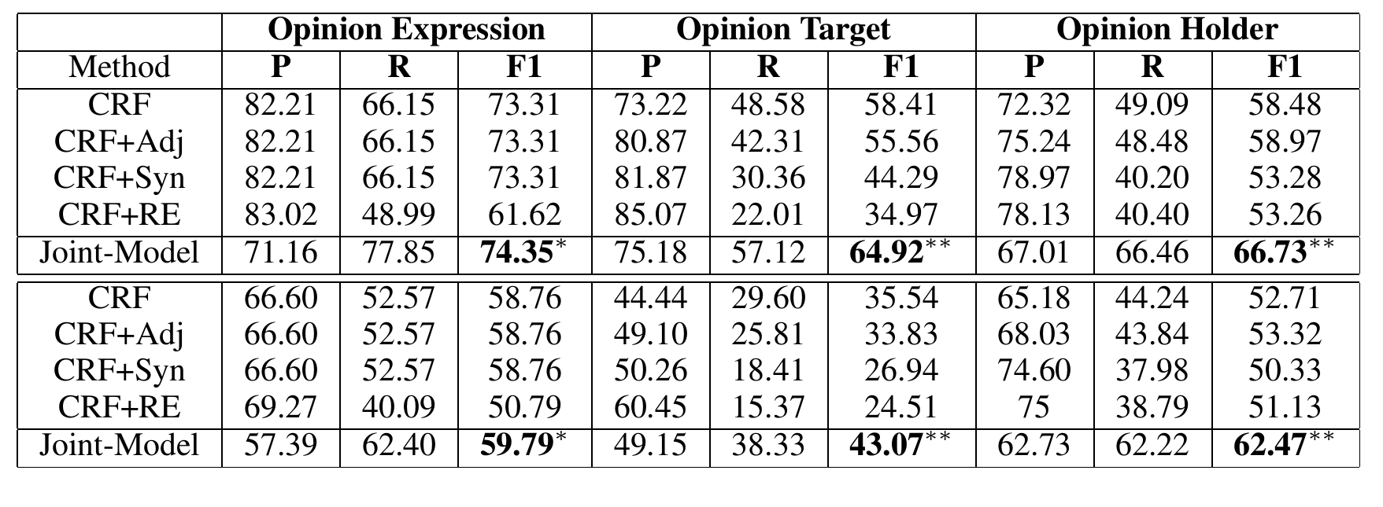
Joint Entity and Sentiment
Results on MPQA
Yang, Bishan, and Claire Cardie. "Joint Inference for Fine-grained Opinion Extraction." ACL (1). 2013.

Slide 47
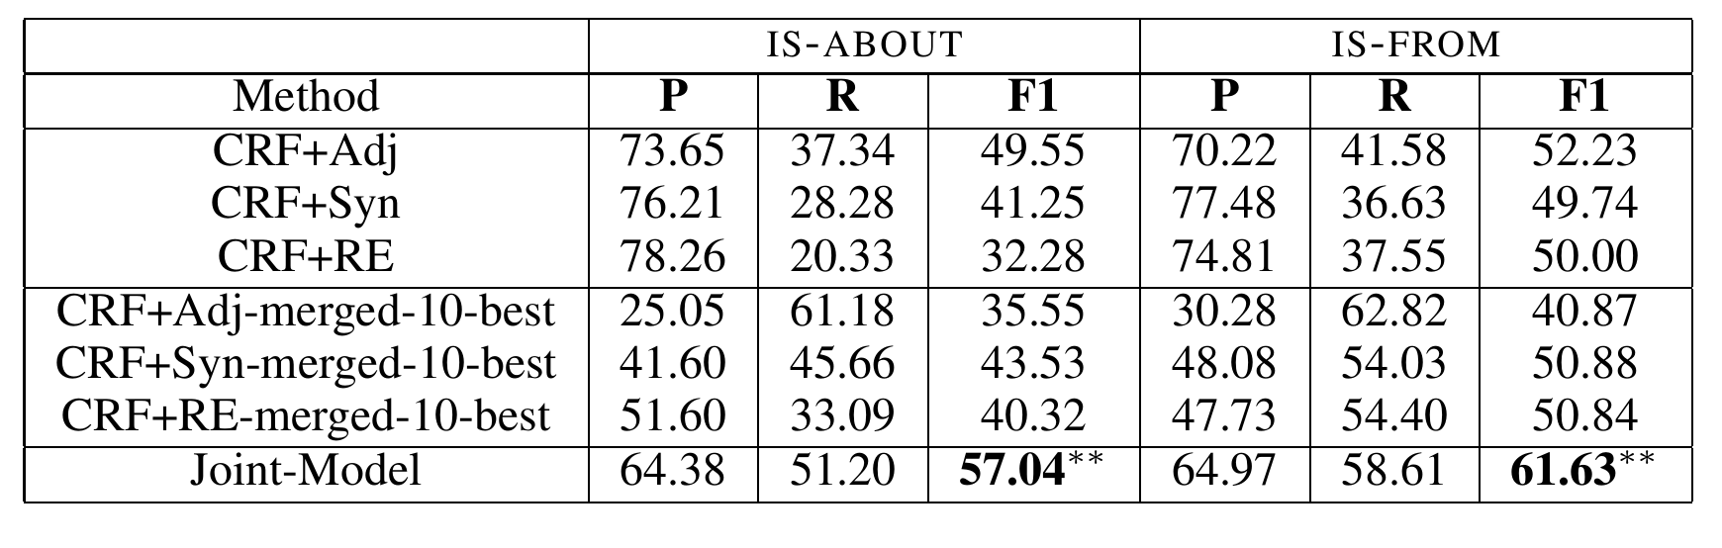
Joint Entity and Sentiment
Results on MPQA
Yang, Bishan, and Claire Cardie. "Joint Inference for Fine-grained Opinion Extraction." ACL (1). 2013.

Slide 48
Joint Supertagging and Parsing
CCG parsing (for English, Chinese and other languages) is to find the syntactic structures of written text based on combinatory categorial grammars.
Marcel
proved
completeness
NP
(S\ NP)/NP
NP
S\ NP
S
Supper tagging and parsing
Auli, Michael, and Adam Lopez. "A comparison of loopy belief propagation and dual decomposition for integrated CCG supertagging and parsing." Proceedings of the 49th Annual Meeting of the Association for Computational Linguistics: Human Language Technologies-Volume 1. Association for Computational Linguistics, 2011.

Slide 49
Joint Supertagging and Parsing
CCG traditionally done by supertagging -> parsing
Auli, Michael, and Adam Lopez. "A comparison of loopy belief propagation and dual decomposition for integrated CCG supertagging and parsing." Proceedings of the 49th Annual Meeting of the Association for Computational Linguistics: Human Language Technologies-Volume 1. Association for Computational Linguistics, 2011.

Slide 50
Joint Supertagging and Parsing
Tasks
CCG Parsing
Parser
CCG Supertagging
Super tagger
Input

Slide 51
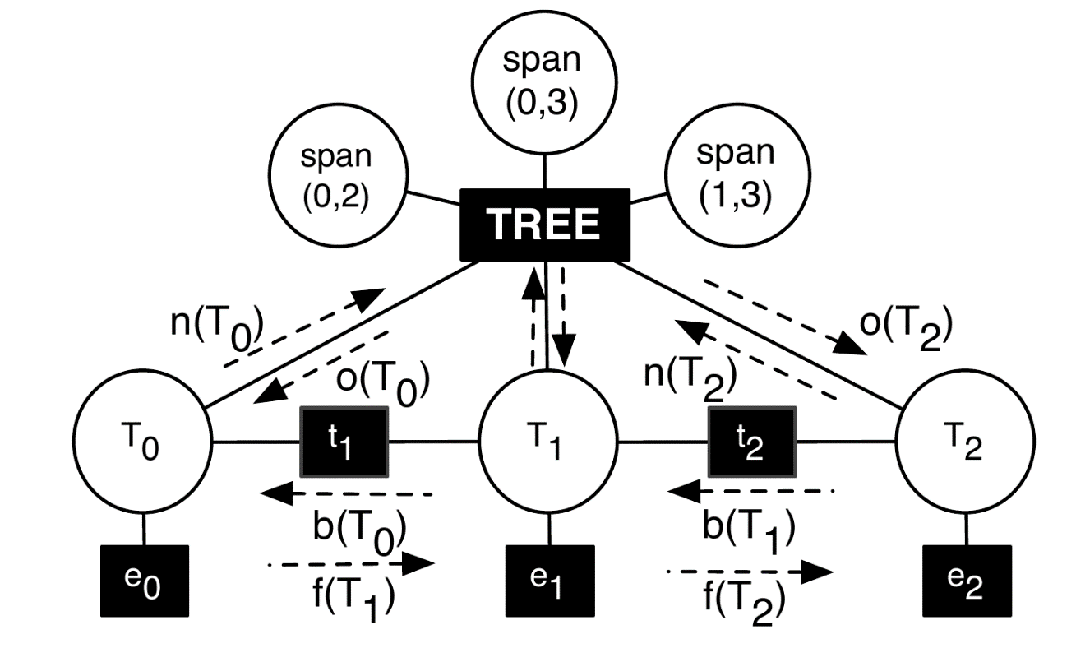
Joint Supertagging and Parsing
Loopy belief propagation: factor graph for the combined parsing and supertagging model
Auli, Michael, and Adam Lopez. "A comparison of loopy belief propagation and dual decomposition for integrated CCG supertagging and parsing." Proceedings of the 49th Annual Meeting of the Association for Computational Linguistics: Human Language Technologies-Volume 1. Association for Computational Linguistics, 2011.

Slide 52
Joint Supertagging and Parsing
Dual decomposition
Auli, Michael, and Adam Lopez. "A comparison of loopy belief propagation and dual decomposition for integrated CCG supertagging and parsing." Proceedings of the 49th Annual Meeting of the Association for Computational Linguistics: Human Language Technologies-Volume 1. Association for Computational Linguistics, 2011.

Slide 53
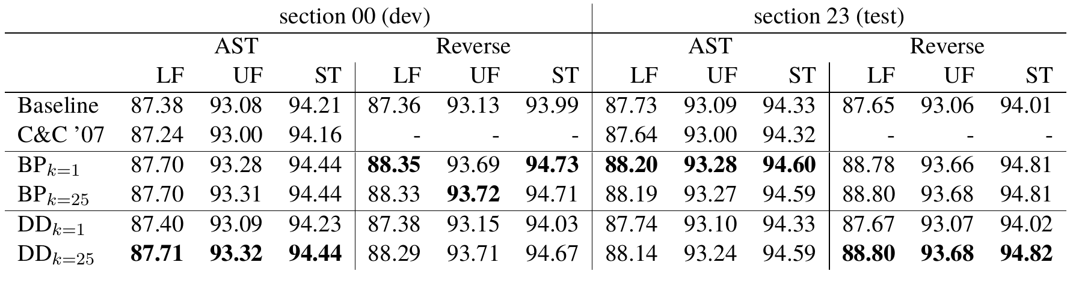
Joint Supertagging and Parsing
Results on CCGBank
Auli, Michael, and Adam Lopez. "A comparison of loopy belief propagation and dual decomposition for integrated CCG supertagging and parsing." Proceedings of the 49th Annual Meeting of the Association for Computational Linguistics: Human Language Technologies-Volume 1. Association for Computational Linguistics, 2011.

Slide 54
Graph-Based Methods
Joint Label Structure
Reranking
Joint Modeling (Multi task)
Joint Modeling (Single task)

Slide 55
Graph-Based Methods
Joint Label Structure
Reranking
Joint Modeling (Multi task)
Joint Modeling (Single task)
Joint Search
,
Joint Learning

Slide 56
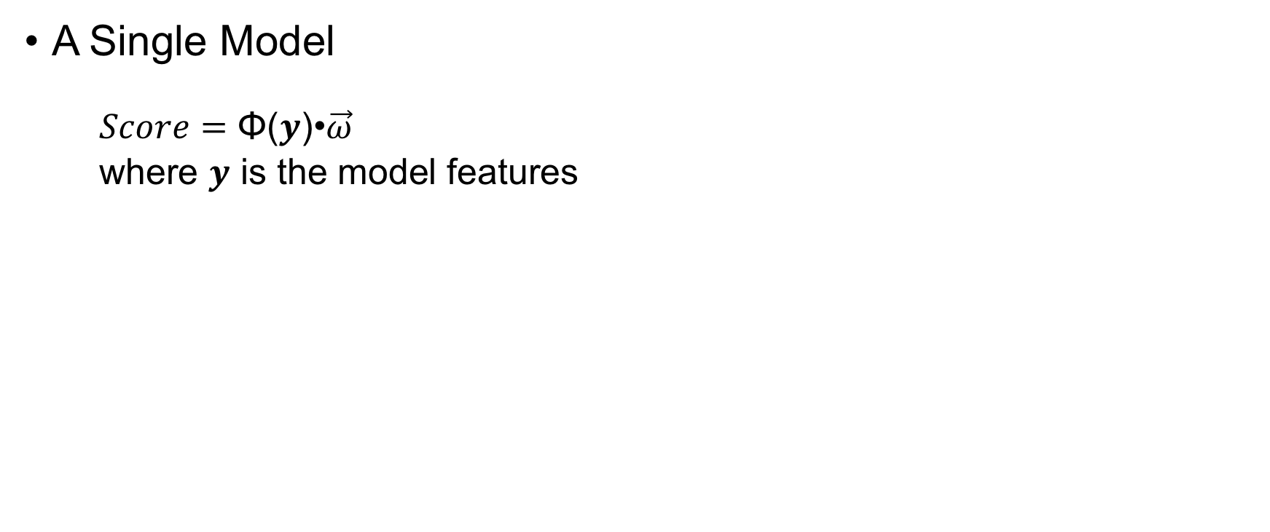
Joint Modeling (Single task)
A Single Model
$Score=\text{Φ}\text{(}y\text{)•}\vec{ω}$
where $y$ is the model features

Slide 57
Joint Segmentation and POS Tagging
Directly model combined output using features.
Input 我喜欢读书 Ilikereadingbooks
Output 我/PN 喜欢/V 读/V 书/N I/PN like/V reading/V books/N
Zhang, Yue, and Stephen Clark. "Joint Word Segmentation and POS Tagging Using a Single Perceptron." ACL. 2008.

Slide 58
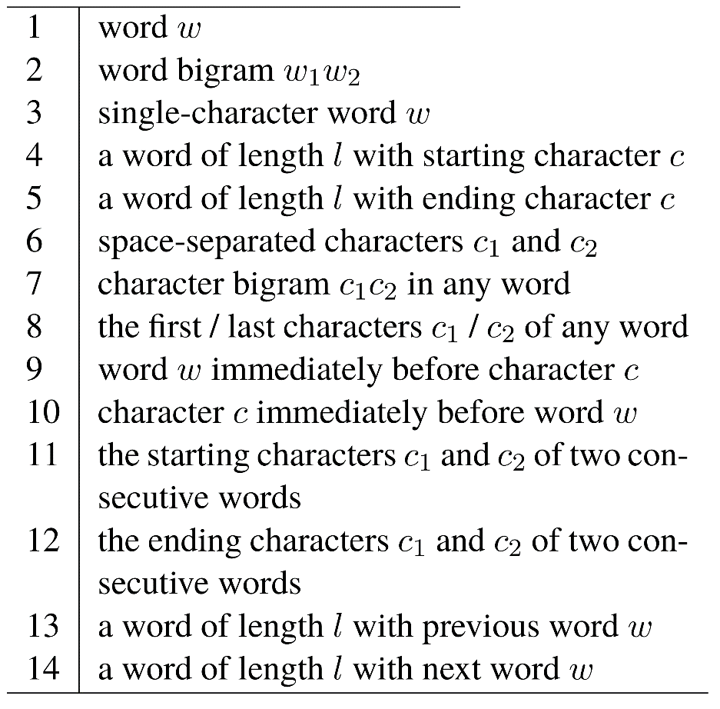
Joint Segmentation and POS Tagging
Feature templates for the baseline segmentor
Zhang, Yue, and Stephen Clark. "Joint Word Segmentation and POS Tagging Using a Single Perceptron." ACL. 2008.

Slide 59
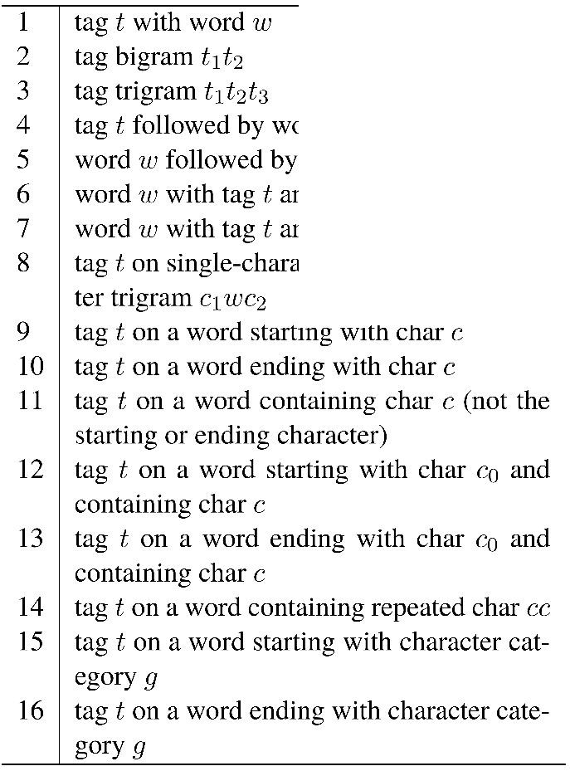
Joint Segmentation and POS Tagging
Feature templates for the baseline POS tagger
Zhang, Yue, and Stephen Clark. "Joint Word Segmentation and POS Tagging Using a Single Perceptron." ACL. 2008.

Slide 60
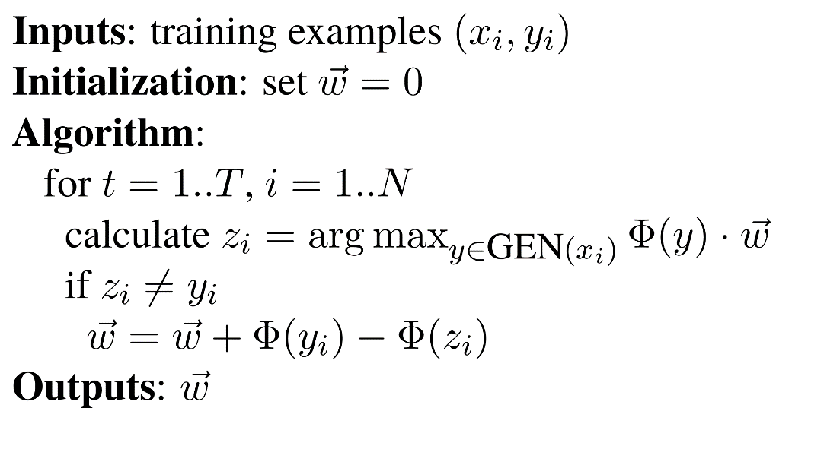
Joint Segmentation and POS Tagging
Averaged perceptron algorithm for training
The perceptron learning algorithm
Zhang, Yue, and Stephen Clark. "Joint Word Segmentation and POS Tagging Using a Single Perceptron." ACL. 2008.

Slide 61
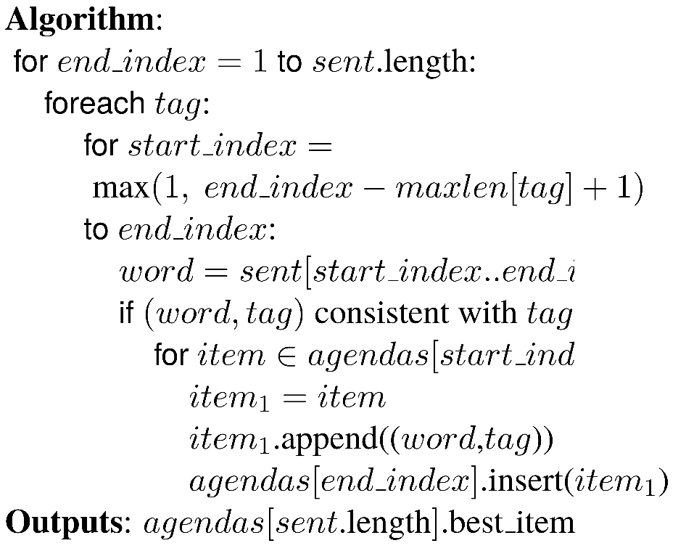
Joint Segmentation and POS Tagging
Beam search decoding: agendas[i] stores the best sequences that end at i
我
PN
我
PN
喜
VV
我
PN
喜欢
VN
我
PN
喜欢
VV
读书
NN
我
PN
喜
NN
喜
NN
我
PN
欢VV
……
我喜
VV
我喜欢
VV
Zhang, Yue, and Stephen Clark. "Joint Word Segmentation and POS Tagging Using a Single Perceptron." ACL. 2008.

Slide 62
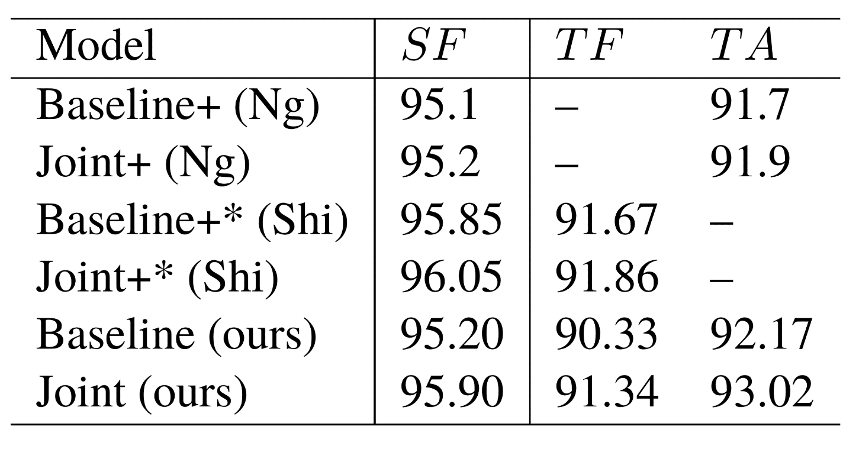
Joint Segmentation and POS Tagging
Results by 10-fold cross validation using CTB
Zhang, Yue, and Stephen Clark. "Joint Word Segmentation and POS Tagging Using a Single Perceptron." ACL. 2008.

Slide 63
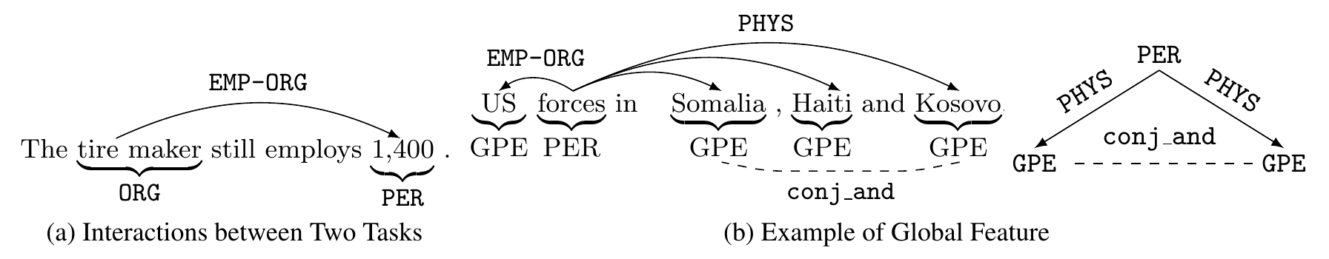
Joint Entity Relation Extraction
Task
Li, Qi, and Heng Ji. "Incremental Joint Extraction of Entity Mentions and Relations." ACL (1). 2014.

Slide 64
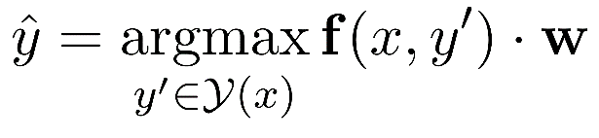
Joint Entity Relation Extraction
A Single Model
Beam Search
Li, Qi, and Heng Ji. "Incremental Joint Extraction of Entity Mentions and Relations." ACL (1). 2014.

Slide 65
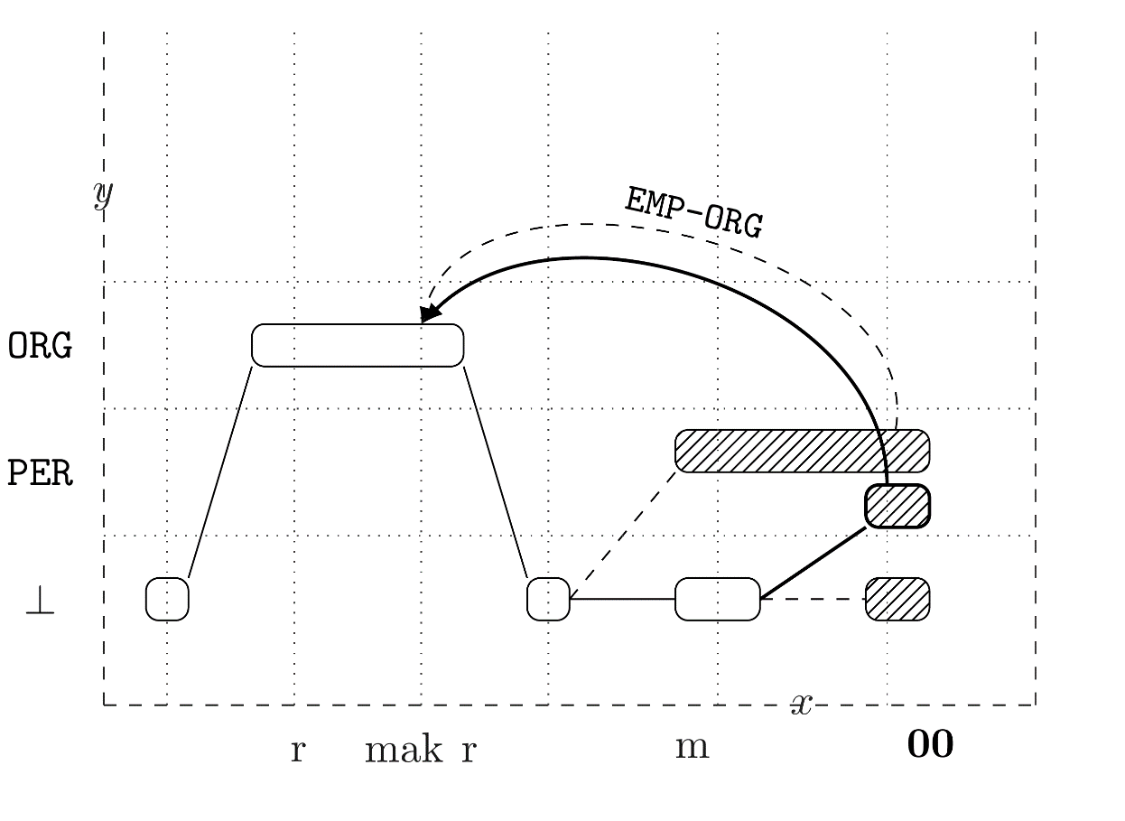
Joint Entity Relation Extraction
Example of decoding steps
Li, Qi, and Heng Ji. "Incremental Joint Extraction of Entity Mentions and Relations." ACL (1). 2014.

Slide 66
Joint Entity Relation Extraction
Feature
Local features
Gazetteer features
Case features
Contextual features
Parsing-based features
Global entity mention features
Coreference consistency
Neighbor coherence
Part-of-whole consistency
Global relation features
Role coherence
Triangle constraint
Inter-dependent compatibility
Neighbor coherence
Li, Qi, and Heng Ji. "Incremental Joint Extraction of Entity Mentions and Relations." ACL (1). 2014.

Slide 67
Joint Entity Relation Extraction
Experiments
Data:
Training data: ACE’05
Validation data: ACE’04
Li, Qi, and Heng Ji. "Incremental Joint Extraction of Entity Mentions and Relations." ACL (1). 2014.

Slide 68
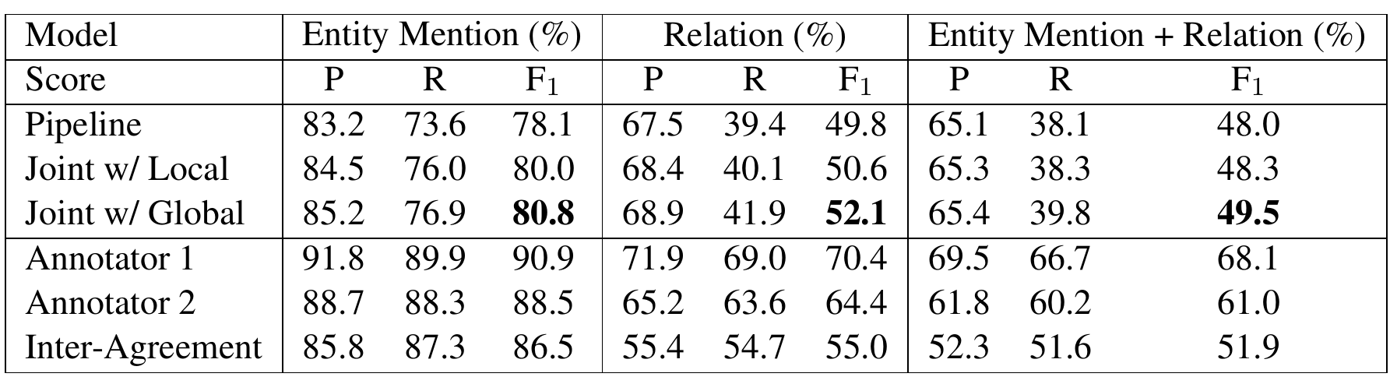
Joint Entity Relation Extraction
Results on ACE
Li, Qi, and Heng Ji. "Incremental Joint Extraction of Entity Mentions and Relations." ACL (1). 2014.

Slide 69
Statistical Models
Graph-Based Methods
Transition-Based Methods

Slide 70
A Transition System
Automata
State
Start state —— an empty structure
End state —— the output structure
Intermediate states —— partially constructed structures
Actions
Change one state to another
Yue Zhang and Stephen Clark. 2011. Syntactic Processing Using the Generalized Perceptron and Beam Search. In Computational Linguistics, 37(1), March.

Slide 71
A Transition System
Automata
start
Yue Zhang and Stephen Clark. 2011. Syntactic Processing Using the Generalized Perceptron and Beam Search. In Computational Linguistics, 37(1), March.

Slide 72
A Transition System
Automata
a₀
start
S₁
Yue Zhang and Stephen Clark. 2011. Syntactic Processing Using the Generalized Perceptron and Beam Search. In Computational Linguistics, 37(1), March.

Slide 73
A Transition System
Automata
a₀
a₁
start
S₁
…
Yue Zhang and Stephen Clark. 2011. Syntactic Processing Using the Generalized Perceptron and Beam Search. In Computational Linguistics, 37(1), March.

Slide 74
A Transition System
Automata
a₀
a₁
a_{i-1}
start
S₁
S_{i}
…
Yue Zhang and Stephen Clark. 2011. Syntactic Processing Using the Generalized Perceptron and Beam Search. In Computational Linguistics, 37(1), March.

Slide 75
A Transition System
Automata
a₀
a₁
a_{i-1}
a_{i}
start
S₁
S_{i}
…
…
Yue Zhang and Stephen Clark. 2011. Syntactic Processing Using the Generalized Perceptron and Beam Search. In Computational Linguistics, 37(1), March.

Slide 76
A Transition System
Automata
a₀
a₁
a_{i-1}
a_{i}
a_{n-1}
start
S₁
S_{i}
S_{n}
…
…
Yue Zhang and Stephen Clark. 2011. Syntactic Processing Using the Generalized Perceptron and Beam Search. In Computational Linguistics, 37(1), March.

Slide 77
A Transition System
Automata
a₀
a₁
a_{i-1}
a_{i}
a_{n-1}
a_{n}
start
S₁
S_{i}
S_{n}
end
…
…
Yue Zhang and Stephen Clark. 2011. Syntactic Processing Using the Generalized Perceptron and Beam Search. In Computational Linguistics, 37(1), March.

Slide 78
A Transition System
State
Corresponds to partial results during decoding
start state, end state, S_{i}
Actions
The operations that can be applied for state transition
Construct output incrementally
a_{i}
a₀
a₁
a_{i-1}
a_{i}
a_{n-1}
a_{n}
start
S₁
S_{i}
S_{n}
end
…
…
Yue Zhang and Stephen Clark. 2011. Syntactic Processing Using the Generalized Perceptron and Beam Search. In Computational Linguistics, 37(1), March.

Slide 79
Transition-based Dependency Parsing
An Example
S-SHIFT
R-REDUCE
AL-ARC-LEFT
AR-ARC-RIGHT
He does it here
Yue Zhang and Stephen Clark. 2011. Syntactic Processing Using the Generalized Perceptron and Beam Search. In Computational Linguistics, 37(1), March.

Slide 80
Transition-based Dependency Parsing
An Example
S-SHIFT
R-REDUCE
AL-ARC-LEFT
AR-ARC-RIGHT
He does it here
S
He
does it here
Yue Zhang and Stephen Clark. 2011. Syntactic Processing Using the Generalized Perceptron and Beam Search. In Computational Linguistics, 37(1), March.

Slide 81
Transition-based Dependency Parsing
An Example
S-SHIFT
R-REDUCE
AL-ARC-LEFT
AR-ARC-RIGHT
He does it here
S
He
AL
does it here
does it here
He
Yue Zhang and Stephen Clark. 2011. Syntactic Processing Using the Generalized Perceptron and Beam Search. In Computational Linguistics, 37(1), March.

Slide 82
Transition-based Dependency Parsing
An Example
S-SHIFT
R-REDUCE
AL-ARC-LEFT
AR-ARC-RIGHT
He does it here
S
He
AL
S
does it here
does it here
does
it here
He
He
Yue Zhang and Stephen Clark. 2011. Syntactic Processing Using the Generalized Perceptron and Beam Search. In Computational Linguistics, 37(1), March.

Slide 83
Transition-based Dependency Parsing
AR
An Example
S-SHIFT
R-REDUCE
AL-ARC-LEFT
AR-ARC-RIGHT
He does it here
S
He
AL
S
does it here
does it here
does
it here
He
He
does it
here
He
Yue Zhang and Stephen Clark. 2011. Syntactic Processing Using the Generalized Perceptron and Beam Search. In Computational Linguistics, 37(1), March.

Slide 84
Transition-based Dependency Parsing
AR
An Example
S-SHIFT
R-REDUCE
AL-ARC-LEFT
AR-ARC-RIGHT
He does it here
S
He
AL
S
does it here
does it here
it here
does
He
He
does
here
does it
R
here
He
it
He
Yue Zhang and Stephen Clark. 2011. Syntactic Processing Using the Generalized Perceptron and Beam Search. In Computational Linguistics, 37(1), March.

Slide 85
Transition-based Dependency Parsing
AR
An Example
S-SHIFT
R-REDUCE
AL-ARC-LEFT
AR-ARC-RIGHT
He does it here
S
He
AL
S
does it here
does it here
does
it here
He
He
does here
does
here
does it
AR
R
here
He
it
He
it
He
Yue Zhang and Stephen Clark. 2011. Syntactic Processing Using the Generalized Perceptron and Beam Search. In Computational Linguistics, 37(1), March.

Slide 86
Transition-based Dependency Parsing
AR
An Example
S-SHIFT
R-REDUCE
AL-ARC-LEFT
AR-ARC-RIGHT
He does it here
S
He
AL
S
does it here
does it here
does
it here
He
He
does
does here
does
here
does it
R
AR
R
here
He
it
here
He
it
He
it
He
Yue Zhang and Stephen Clark. 2011. Syntactic Processing Using the Generalized Perceptron and Beam Search. In Computational Linguistics, 37(1), March.

Slide 87
Search Space
Similar challenged to graph-based models
Typical exponential
S_{n}
a_{n-1}
S₂
a₂
⁞⁞⁞
S’_{n}
a’₂
a’_{n-1}
a₁
a’’₂
S₁
a’₁
S’₂
…
a’’_{n-1}
S’’_{n}
a’’₁
S’’₂
a₀
…
S₀
S’₁
•••
⁞⁞⁞
•••
a’₀
…
…
…
a’’₀
⁞
⁞
⁞
S’’₁
…
•••
•••
…
⁞⁞⁞
…
…
•••
Yue Zhang and Stephen Clark. 2011. Syntactic Processing Using the Generalized Perceptron and Beam Search. In Computational Linguistics, 37(1), March.

Slide 88
A Learning+Search Framework
start
Yue Zhang and Stephen Clark. 2011. Syntactic Processing Using the Generalized Perceptron and Beam Search. In Computational Linguistics, 37(1), March.

Slide 89
A Learning+Search Framework
agenda
S₁₁
S₁₂
S₁₃
start
…
S_{1k}
…
Yue Zhang and Stephen Clark. 2011. Syntactic Processing Using the Generalized Perceptron and Beam Search. In Computational Linguistics, 37(1), March.

Slide 90
A Learning+Search Framework
agenda
S₁₁
…
S₁₂
…
S₁₃
…
start
…
…
S_{1k}
…
…
…
…
…
Yue Zhang and Stephen Clark. 2011. Syntactic Processing Using the Generalized Perceptron and Beam Search. In Computational Linguistics, 37(1), March.

Slide 91
A Learning+Search Framework
agenda
S₁₁
…
S_{i1}
S₁₂
…
S_{i2}
S₁₃
…
S_{i3}
start
…
…
…
S_{1k}
…
S_{ik}
…
…
…
…
…
…
…
Yue Zhang and Stephen Clark. 2011. Syntactic Processing Using the Generalized Perceptron and Beam Search. In Computational Linguistics, 37(1), March.

Slide 92
A Learning+Search Framework
agenda
S₁₁
…
S_{i1}
…
End₁
S₁₂
…
S_{i2}
…
End₂
S₁₃
…
S_{i3}
…
End₃
start
…
…
…
…
…
S_{1k}
…
S_{ik}
…
End_{K}
…
…
…
…
…
…
…
…
…
…
…
…
…
Yue Zhang and Stephen Clark. 2011. Syntactic Processing Using the Generalized Perceptron and Beam Search. In Computational Linguistics, 37(1), March.

Slide 93
A Learning+Search Framework
Dependency Parsing Example
Decoding
He does it here
Yue Zhang and Stephen Clark. 2011. Syntactic Processing Using the Generalized Perceptron and Beam Search. In Computational Linguistics, 37(1), March.

Slide 94
A Learning+Search Framework
Dependency Parsing Example
Decoding
He does it here
S
He
does it here
Yue Zhang and Stephen Clark. 2011. Syntactic Processing Using the Generalized Perceptron and Beam Search. In Computational Linguistics, 37(1), March.

Slide 95
A Learning+Search Framework
Dependency Parsing Example
Decoding
He does it here
S
He
AL
does it here
does it here
AR
He
S
He does
it here
He does
it here
Yue Zhang and Stephen Clark. 2011. Syntactic Processing Using the Generalized Perceptron and Beam Search. In Computational Linguistics, 37(1), March.

Slide 96
A Learning+Search Framework
Dependency Parsing Example
Decoding
He does it here
S
He
AL
S
does it here
does it here
it here
does
AR
He
He
S
He does
S
it here
He does it
here
AR
He does
it here
He does it
here
S
AR
Yue Zhang and Stephen Clark. 2011. Syntactic Processing Using the Generalized Perceptron and Beam Search. In Computational Linguistics, 37(1), March.

Slide 97
A Learning+Search Framework
Dependency Parsing Example
Decoding
He does it here
S
He
AL
S
does it here
does it here
it here
does
AR
He
He
S
He does
S
it here
He does it
here
AR
He does
it here
He does it
here
S
AR
does it
here
He
He does it here
here
He does
it
Yue Zhang and Stephen Clark. 2011. Syntactic Processing Using the Generalized Perceptron and Beam Search. In Computational Linguistics, 37(1), March.

Slide 98
A Learning+Search Framework
Dependency Parsing Example
Decoding
He does it here
S
He
AL
S
does it here
does it here
it here
does
AR
He
He
S
He does
S
it here
He does it
here
AR
He does
it here
He does it
here
S
AR
does it here
does it
here
He
He
He
does
here
He
it
He does it here
He
does it here
here
He does
He
it
Yue Zhang and Stephen Clark. 2011. Syntactic Processing Using the Generalized Perceptron and Beam Search. In Computational Linguistics, 37(1), March.

Slide 99
A Learning+Search Framework
Dependency Parsing Example
Decoding
He does it here
S
He
AL
S
does it here
does it here
it here
does
AR
He
He
S
He does
S
it here
He does it
here
AR
He does
it here
He does it
here
S
AR
does here
does it here
does it
here
He
it
He
He
He
does here
does
here
He
it
He does it here
He
it
He
does it here
does it here
here
He does
He
He
it
Yue Zhang and Stephen Clark. 2011. Syntactic Processing Using the Generalized Perceptron and Beam Search. In Computational Linguistics, 37(1), March.

Slide 100
A Learning+Search Framework
Dependency Parsing Example
Decoding
He does it here
S
He
AL
S
does it here
does it here
it here
does
AR
He
He
S
He does
S
it here
He does it
here
AR
He does
it here
He does it
here
S
AR
does
does here
does it here
does it
here
He
it
He
it
He
here
He
He
does here
does
here
He
it
He does it here
He
it
He
does it
does it here
does it here
here
He does
He here
He
He
it
Yue Zhang and Stephen Clark. 2011. Syntactic Processing Using the Generalized Perceptron and Beam Search. In Computational Linguistics, 37(1), March.

Slide 101
A Learning+Search Framework
Search not optional (vs graph-based structured prediction)
Learn to fix search errors
agenda
S₁₁
S₂₁
S_{i1}
S₁₂
S₂₂
S_{i2}
S₁₃
S₂₃
S_{i3}
start
…
…
…
S_{1k}
…
S_{ik}
Positive example
start
S₁₁
S₂₂
……
S_{jk+1}
…
S_{jk+1}
…
…
…
Negative
example
start
S₁₁
S₂₁
……
S_{j1}
…
…

Slide 102
A Learning+Search Framework
Advantages
Low computation complexity
Arbitrary non-local features
Learning-guided-search
Yue Zhang and Stephen Clark. 2011. Syntactic Processing Using the Generalized Perceptron and Beam Search. In Computational Linguistics, 37(1), March.

Slide 103
A Learning+Search Framework
State-of-the-art accuracies and speeds
Constituent parsing
Dependency parsing
Word Segmentation
CCG parsing
Enable joint models
Address complex search space and use joint features, which have been difficult for traditional models
Yue Zhang and Stephen Clark. 2011. Syntactic Processing Using the Generalized Perceptron and Beam Search. In Computational Linguistics, 37(1), March.

Slide 104
A Learning+Search Framework
State-of-the-art accuracies and speeds
Constituent parsing
Dependency parsing
Word Segmentation
CCG parsing
Enable joint models
Address complex search space and use joint features, which have been difficult for traditional models
Joint Search
Joint Learning
Yue Zhang and Stephen Clark. 2011. Syntactic Processing Using the Generalized Perceptron and Beam Search. In Computational Linguistics, 37(1), March.

Slide 105
A Learning+Search Framework
Global Normalization for Neural Structured Prediction
Zhou et al., (2015)
Watanabe et al., (2015)
Andor et al., (2016)
Rush et al., (2016)
Hao Zhou, Yue Zhang, Shujian Huang and Jiajun Chen. A Neural Probabilistic Structured-Prediction Model for Transition-based Dependency Parsing. In Proceedings of ACL 2015, Beijing, China, July.
Watanabe, Taro, and Eiichiro Sumita. "Transition-based neural constituent parsing." Proceedings of the 53rd Annual Meeting of the Association for Computational Linguistics and the 7th International Joint Conference on Natural Language Processing (Volume 1: Long Papers). Vol. 1. 2015.
Andor Daniel, Chris Alberti, David Weiss, Aliaksei Severyn, Alessandro Presta, Kuzman Ganchev, Slav Petrov, Michael Collins "Globally normalized transition-based neural networks." arXiv preprint arXiv:1603.06042 (2016).
Wiseman, Sam, and Alexander M. Rush. "Sequence-to-sequence learning as beam-search optimization." arXiv preprint arXiv:1606.02960 (2016).

Slide 106
Joint Segmentation and POS Tagging
The transition system
State
Partial segmented results
Unprocessed characters
Two actions
Separate (t) : t is a POS tag
Append
Yue Zhang and Stephen Clark. A Fast Decoder for Joint Word Segmentation and POS-tagging Using a Single Discriminative Model. In proceedings of EMNLP 2010. Massachusetts, USA. October.
Zhang and Clark, EMNLP 2010

Slide 107
Joint Segmentation and POS Tagging
The transition system
Initial state
我喜欢读书
Yue Zhang and Stephen Clark. A Fast Decoder for Joint Word Segmentation and POS-tagging Using a Single Discriminative Model. In proceedings of EMNLP 2010. Massachusetts, USA. October.

Slide 108
Joint Segmentation and POS Tagging
The transition system
Separate(PN)
我/PN
喜欢读书
Yue Zhang and Stephen Clark. A Fast Decoder for Joint Word Segmentation and POS-tagging Using a Single Discriminative Model. In proceedings of EMNLP 2010. Massachusetts, USA. October.

Slide 109
Joint Segmentation and POS Tagging
The transition system
Separate (V)
我/PN 喜/V
欢读书
Yue Zhang and Stephen Clark. A Fast Decoder for Joint Word Segmentation and POS-tagging Using a Single Discriminative Model. In proceedings of EMNLP 2010. Massachusetts, USA. October.

Slide 110
Joint Segmentation and POS Tagging
The transition system
Append
我/PN 喜欢/V
读书
Yue Zhang and Stephen Clark. A Fast Decoder for Joint Word Segmentation and POS-tagging Using a Single Discriminative Model. In proceedings of EMNLP 2010. Massachusetts, USA. October.

Slide 111
Joint Segmentation and POS Tagging
The transition system
Separate (V)
我/PN 喜欢/V 读/V
书
Yue Zhang and Stephen Clark. A Fast Decoder for Joint Word Segmentation and POS-tagging Using a Single Discriminative Model. In proceedings of EMNLP 2010. Massachusetts, USA. October.

Slide 112
Joint Segmentation and POS Tagging
The transition system
Separate (N)
我/PN 喜欢/V 读/V 书/N
Yue Zhang and Stephen Clark. A Fast Decoder for Joint Word Segmentation and POS-tagging Using a Single Discriminative Model. In proceedings of EMNLP 2010. Massachusetts, USA. October.

Slide 113
Joint Segmentation and POS Tagging
The transition system
End state
我/PN 喜欢/V 读/V 书/N
Yue Zhang and Stephen Clark. A Fast Decoder for Joint Word Segmentation and POS-tagging Using a Single Discriminative Model. In proceedings of EMNLP 2010. Massachusetts, USA. October.

Slide 114
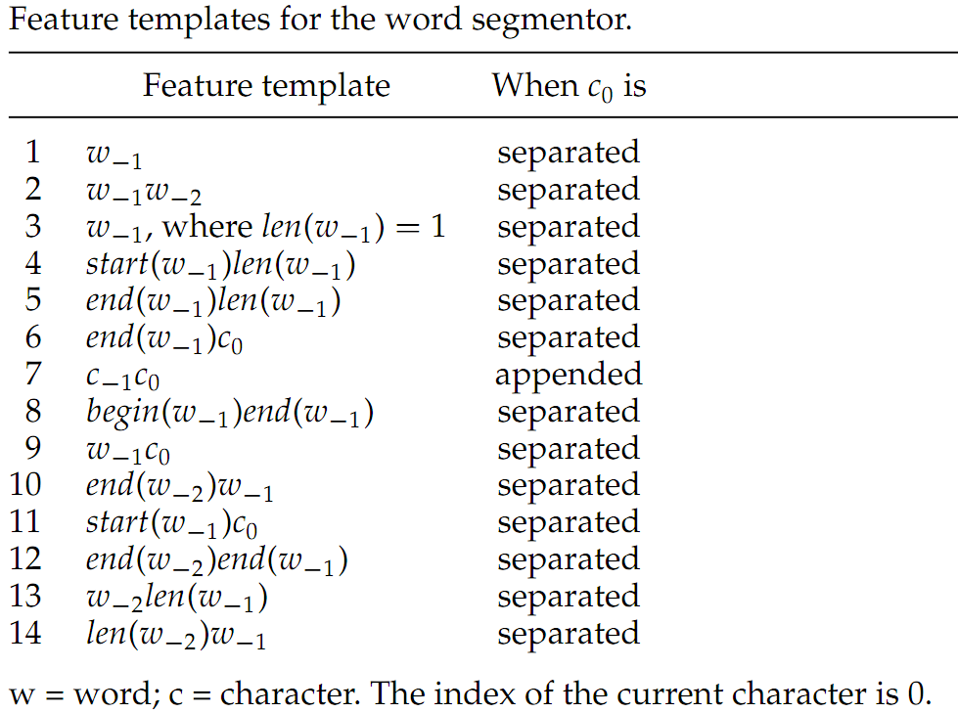
Joint Segmentation and POS Tagging
Segmentation Feature templates
Non-local
Yue Zhang and Stephen Clark. A Fast Decoder for Joint Word Segmentation and POS-tagging Using a Single Discriminative Model. In proceedings of EMNLP 2010. Massachusetts, USA. October.

Slide 115
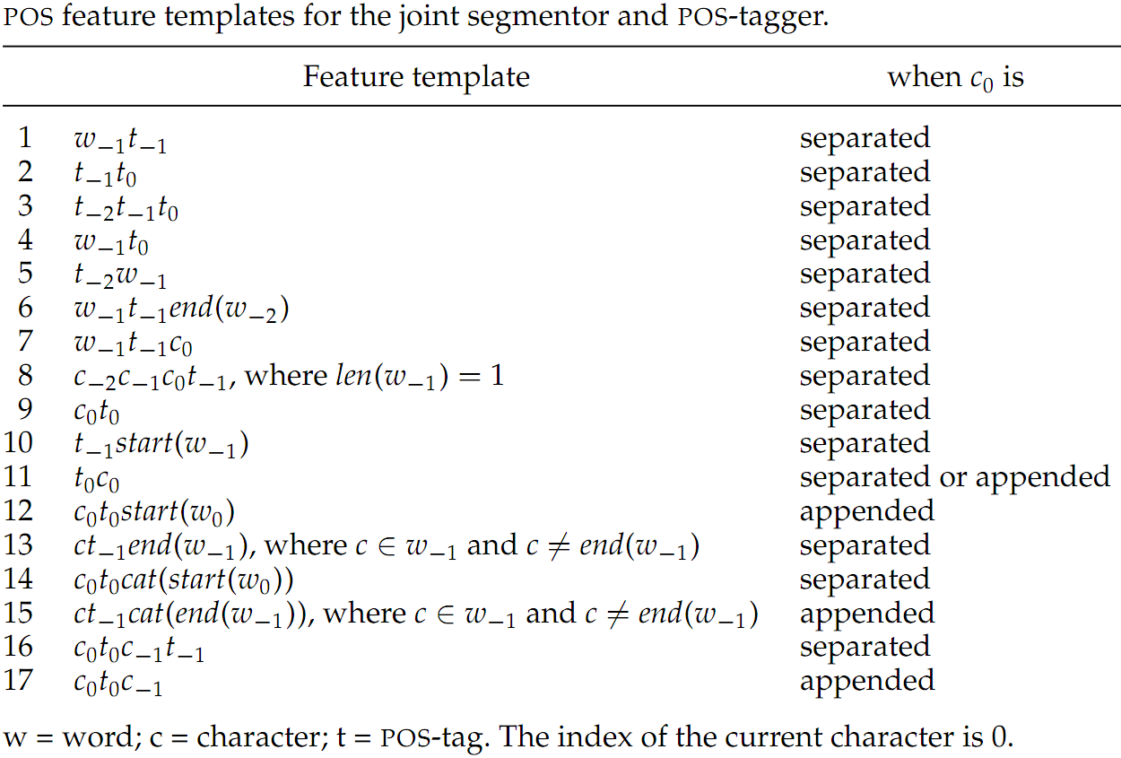
Joint Segmentation and POS Tagging
POS Feature templates
Word-level
Yue Zhang and Stephen Clark. A Fast Decoder for Joint Word Segmentation and POS-tagging Using a Single Discriminative Model. In proceedings of EMNLP 2010. Massachusetts, USA. October.

Slide 116
Joint Segmentation and POS Tagging
Experiments on CTB 5
 | SF | JF
K09 (error-driven) | 97.87 | 93.67
This work | 97.78 | 93.67
Zhang 2008 | 97.82 | 93.62
K09 (baseline) | 97.79 | 93.60
J08a | 97.85 | 93.41
J08b | 97.74 | 93.37
N07 | 97.83 | 93.32
SF = segmentation F-score; JF = joint segmentation and POS-tagging F-score
Yue Zhang and Stephen Clark. A Fast Decoder for Joint Word Segmentation and POS-tagging Using a Single Discriminative Model. In proceedings of EMNLP 2010. Massachusetts, USA. October.

Slide 117
Joint Segmentation/Tagging/Chunking
Input 他到达北京机场。 Output [NP 他/NR] [VP 到达/VV] [NP 北京/NR 机场/NN] [O 。/PU]
[He] [arrived] [Beijing airport] [.]
Chunking knowledge can potentially improve segmentation/tagging.
To address the sparsity of full chunk features, a semi-supervised method is proposed to derive chunk cluster features from large-scale automatically-chunked data.
Chen Lyu, Yue Zhang and Donghong Ji. Joint Word Segmentation, POS-Tagging and Syntactic Chunking. In Proceedings of the AAAI 2016, Phoenix, Arizona, USA, February.

Slide 118
Joint Segmentation/Tagging/Chunking
Character-based chunking
Action: initial state
stack
queue1
queue2
他 到 达 北 京 机 场 。
[NP 他/NR] [VP 到达/VV] [NP 北京/NR 机场/NN] [O 。/PU]
[He] [arrived] [Beijing airport] [.]
Chen Lyu, Yue Zhang and Donghong Ji. Joint Word Segmentation, POS-Tagging and Syntactic Chunking. In Proceedings of the AAAI 2016, Phoenix, Arizona, USA, February.

Slide 119
Joint Segmentation/Tagging/Chunking
Character-based chunking
Action: SEP(NR)
stack
queue1
queue2
deque
queue
[他/NR
到 达 北 京 机 场 。
[NP 他/NR] [VP 到达/VV] [NP 北京/NR 机场/NN] [O 。/PU]
[He] [arrived] [Beijing airport] [.]
Chen Lyu, Yue Zhang and Donghong Ji. Joint Word Segmentation, POS-Tagging and Syntactic Chunking. In Proceedings of the AAAI 2016, Phoenix, Arizona, USA, February.

Slide 120
Joint Segmentation/Tagging/Chunking
Character-based chunking
Action: FIN W
stack
queue1
queue2
deque
queue
[他/NR]
到 达 北 京 机 场 。
[NP 他/NR] [VP 到达/VV] [NP 北京/NR 机场/NN] [O 。/PU]
[He] [arrived] [Beijing airport] [.]
Chen Lyu, Yue Zhang and Donghong Ji. Joint Word Segmentation, POS-Tagging and Syntactic Chunking. In Proceedings of the AAAI 2016, Phoenix, Arizona, USA, February.

Slide 121
Joint Segmentation/Tagging/Chunking
Character-based chunking
Action: SEP(NP)
stack
queue1
queue2
deque
queue
[NP 他/NR]
到 达 北 京 机 场 。
[NP 他/NR] [VP 到达/VV] [NP 北京/NR 机场/NN] [O 。/PU]
[He] [arrived] [Beijing airport] [.]
Chen Lyu, Yue Zhang and Donghong Ji. Joint Word Segmentation, POS-Tagging and Syntactic Chunking. In Proceedings of the AAAI 2016, Phoenix, Arizona, USA, February.

Slide 122
Joint Segmentation/Tagging/Chunking
Character-based chunking
Action: SEP(VV)
stack
queue1
queue2
deque
queue
[NP 他/NR]
[到/VV
达 北 京 机 场 。
[NP 他/NR] [VP 到达/VV] [NP 北京/NR 机场/NN] [O 。/PU]
[He] [arrived] [Beijing airport] [.]
Chen Lyu, Yue Zhang and Donghong Ji. Joint Word Segmentation, POS-Tagging and Syntactic Chunking. In Proceedings of the AAAI 2016, Phoenix, Arizona, USA, February.

Slide 123
Joint Segmentation/Tagging/Chunking
Character-based chunking
Action: APP W
stack
queue1
queue2
deque
queue
[NP 他/NR]
[到达/VV
北 京 机 场 。
[NP 他/NR] [VP 到达/VV] [NP 北京/NR 机场/NN] [O 。/PU]
[He] [arrived] [Beijing airport] [.]
Chen Lyu, Yue Zhang and Donghong Ji. Joint Word Segmentation, POS-Tagging and Syntactic Chunking. In Proceedings of the AAAI 2016, Phoenix, Arizona, USA, February.

Slide 124
Joint Segmentation/Tagging/Chunking
Character-based chunking
Action: FIN W
stack
queue1
queue2
deque
queue
[NP 他/NR]
[到达/VV]
北 京 机 场 。
[NP 他/NR] [VP 到达/VV] [NP 北京/NR 机场/NN] [O 。/PU]
[He] [arrived] [Beijing airport] [.]
Chen Lyu, Yue Zhang and Donghong Ji. Joint Word Segmentation, POS-Tagging and Syntactic Chunking. In Proceedings of the AAAI 2016, Phoenix, Arizona, USA, February.

Slide 125
Joint Segmentation/Tagging/Chunking
Character-based chunking
Action: SEP(VP)
stack
queue1
queue2
deque
queue
[NP 他/NR]
[VP 到达/VV]
北 京 机 场 。
[NP 他/NR] [VP 到达/VV] [NP 北京/NR 机场/NN] [O 。/PU]
[He] [arrived] [Beijing airport] [.]
Chen Lyu, Yue Zhang and Donghong Ji. Joint Word Segmentation, POS-Tagging and Syntactic Chunking. In Proceedings of the AAAI 2016, Phoenix, Arizona, USA, February.

Slide 126
Joint Segmentation/Tagging/Chunking
Character-based chunking
Action: SEP(NR)
stack
queue1
queue2
deque
queue
[NP 他/NR]
[VP 到达/VV]
[北/NR
京 机 场 。
[NP 他/NR] [VP 到达/VV] [NP 北京/NR 机场/NN] [O 。/PU]
[He] [arrived] [Beijing airport] [.]
Chen Lyu, Yue Zhang and Donghong Ji. Joint Word Segmentation, POS-Tagging and Syntactic Chunking. In Proceedings of the AAAI 2016, Phoenix, Arizona, USA, February.

Slide 127
Joint Segmentation/Tagging/Chunking
Character-based chunking
Action: APP W
stack
queue1
queue2
deque
queue
[NP 他/NR]
[VP 到达/VV]
[北京/NR
机 场 。
[NP 他/NR] [VP 到达/VV] [NP 北京/NR 机场/NN] [O 。/PU]
[He] [arrived] [Beijing airport] [.]
Chen Lyu, Yue Zhang and Donghong Ji. Joint Word Segmentation, POS-Tagging and Syntactic Chunking. In Proceedings of the AAAI 2016, Phoenix, Arizona, USA, February.

Slide 128
Joint Segmentation/Tagging/Chunking
Character-based chunking
Action: FIN W
stack
queue1
queue2
deque
queue
[NP 他/NR]
[VP 到达/VV]
[北京/NR]
机 场 。
[NP 他/NR] [VP 到达/VV] [NP 北京/NR 机场/NN] [O 。/PU]
[He] [arrived] [Beijing airport] [.]
Chen Lyu, Yue Zhang and Donghong Ji. Joint Word Segmentation, POS-Tagging and Syntactic Chunking. In Proceedings of the AAAI 2016, Phoenix, Arizona, USA, February.

Slide 129
Joint Segmentation/Tagging/Chunking
Character-based chunking
Action: SEP(NP)
stack
queue1
queue2
deque
queue
[NP 他/NR]
[VP 到达/VV]
[NP 北京/NR]
机 场 。
[NP 他/NR] [VP 到达/VV] [NP 北京/NR 机场/NN] [O 。/PU]
[He] [arrived] [Beijing airport] [.]
Chen Lyu, Yue Zhang and Donghong Ji. Joint Word Segmentation, POS-Tagging and Syntactic Chunking. In Proceedings of the AAAI 2016, Phoenix, Arizona, USA, February.

Slide 130
Joint Segmentation/Tagging/Chunking
Character-based chunking
Action: SEP(NN)
stack
queue1
queue2
deque
queue
[NP 他/NR]
[VP 到达/VV]
[NP 北京/NR]
[机/NN
场 。
[NP 他/NR] [VP 到达/VV] [NP 北京/NR 机场/NN] [O 。/PU]
[He] [arrived] [Beijing airport] [.]
Chen Lyu, Yue Zhang and Donghong Ji. Joint Word Segmentation, POS-Tagging and Syntactic Chunking. In Proceedings of the AAAI 2016, Phoenix, Arizona, USA, February.

Slide 131
Joint Segmentation/Tagging/Chunking
Character-based chunking
Action: APP W
stack
queue1
queue2
deque
queue
[NP 他/NR]
[VP 到达/VV]
[NP 北京/NR]
[机场/NN
。
[NP 他/NR] [VP 到达/VV] [NP 北京/NR 机场/NN] [O 。/PU]
[He] [arrived] [Beijing airport] [.]
Chen Lyu, Yue Zhang and Donghong Ji. Joint Word Segmentation, POS-Tagging and Syntactic Chunking. In Proceedings of the AAAI 2016, Phoenix, Arizona, USA, February.

Slide 132
Joint Segmentation/Tagging/Chunking
Character-based chunking
Action: FIN W
stack
queue1
queue2
deque
queue
[NP 他/NR]
[VP 到达/VV]
[NP 北京/NR]
[机场/NN]
。
[NP 他/NR] [VP 到达/VV] [NP 北京/NR 机场/NN] [O 。/PU]
[He] [arrived] [Beijing airport] [.]
Chen Lyu, Yue Zhang and Donghong Ji. Joint Word Segmentation, POS-Tagging and Syntactic Chunking. In Proceedings of the AAAI 2016, Phoenix, Arizona, USA, February.

Slide 133
Joint Segmentation/Tagging/Chunking
Character-based chunking
Action: APP C
stack
queue1
queue2
deque
queue
[NP 他/NR]
[VP 到达/VV]
[NP 北京/NR 机场/NN]
。
[NP 他/NR] [VP 到达/VV] [NP 北京/NR 机场/NN] [O 。/PU]
[He] [arrived] [Beijing airport] [.]
Chen Lyu, Yue Zhang and Donghong Ji. Joint Word Segmentation, POS-Tagging and Syntactic Chunking. In Proceedings of the AAAI 2016, Phoenix, Arizona, USA, February.

Slide 134
Joint Segmentation/Tagging/Chunking
Character-based chunking
Action: SEP(PU)
stack
queue1
queue2
deque
queue
[NP 他/NR]
[VP 到达/VV]
[NP 北京/NR 机场/NN]
[。/PU
[NP 他/NR] [VP 到达/VV] [NP 北京/NR 机场/NN] [O 。/PU]
[He] [arrived] [Beijing airport] [.]
Chen Lyu, Yue Zhang and Donghong Ji. Joint Word Segmentation, POS-Tagging and Syntactic Chunking. In Proceedings of the AAAI 2016, Phoenix, Arizona, USA, February.

Slide 135
Joint Segmentation/Tagging/Chunking
Character-based chunking
Action: FIN W
stack
queue1
queue2
deque
queue
[NP 他/NR]
[VP 到达/VV]
[NP 北京/NR 机场/NN]
[。/PU]
[NP 他/NR] [VP 到达/VV] [NP 北京/NR 机场/NN] [O 。/PU]
[He] [arrived] [Beijing airport] [.]
Chen Lyu, Yue Zhang and Donghong Ji. Joint Word Segmentation, POS-Tagging and Syntactic Chunking. In Proceedings of the AAAI 2016, Phoenix, Arizona, USA, February.

Slide 136
Joint Segmentation/Tagging/Chunking
Character-based chunking
Action: SEP(O)
stack
queue1
queue2
deque
queue
[NP 他/NR]
[VP 到达/VV]
[NP 北京/NR 机场/NN]
[O 。/PU]
[NP 他/NR] [VP 到达/VV] [NP 北京/NR 机场/NN] [O 。/PU]
[He] [arrived] [Beijing airport] [.]
Chen Lyu, Yue Zhang and Donghong Ji. Joint Word Segmentation, POS-Tagging and Syntactic Chunking. In Proceedings of the AAAI 2016, Phoenix, Arizona, USA, February.

Slide 137
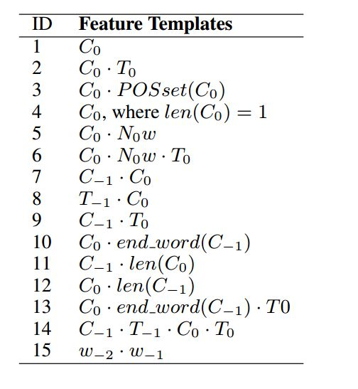
Joint Segmentation/Tagging/Chunking
Character-based chunking feature template
Chen Lyu, Yue Zhang and Donghong Ji. Joint Word Segmentation, POS-Tagging and Syntactic Chunking. In Proceedings of the AAAI 2016, Phoenix, Arizona, USA, February.

Slide 138
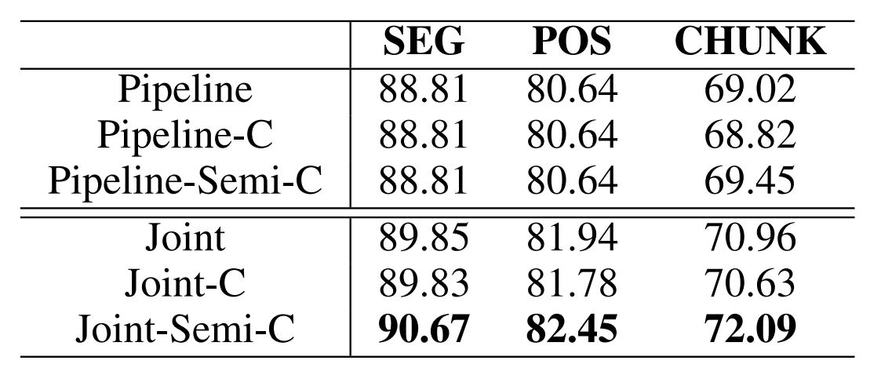
Joint Segmentation/Tagging/Chunking
Results on CTB
Chen Lyu, Yue Zhang and Donghong Ji. Joint Word Segmentation, POS-Tagging and Syntactic Chunking. In Proceedings of the AAAI 2016, Phoenix, Arizona, USA, February.

Slide 139
Joint Segmentation, Tagging and Normalization
Text normalization is introduced as a pre-processing step for microblog processing, which transforms informal words into their standard forms. For example, “tmrw” has been frequently used in tweets for is for “tomorrow”.
This paper proposed a transition-based model for joint word segmentation, POS tagging and text normalization.
pear
work stress big
工作鸭梨大啊！
工作/NN 压力/NN 大/VA 啊/SP !/PU
Tao Qian, Yue Zhang, Meishan Zhang and Donghong Ji. A Transition-based Model for Joint Segmentation, POS-tagging and Normalization. In proceedings of EMNLP 2015, Lisboa, Portugal, September.

Slide 140
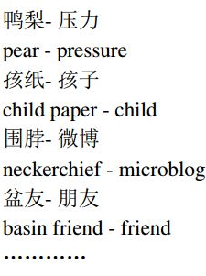
Joint Segmentation, Tagging and Normalization
Normalization dictionary
Tao Qian, Yue Zhang, Meishan Zhang and Donghong Ji. A Transition-based Model for Joint Segmentation, POS-tagging and Normalization. In proceedings of EMNLP 2015, Lisboa, Portugal, September.

Slide 141
Joint Segmentation, Tagging and Normalization
Transition actions for joint segmentation, tagging and normalization
Actions: initial state
stack
queue
工 作 鸭 梨 大 啊 ！
工作/NN 压力/NN 大/VA 啊/SP !/PU
Work stress big ah !
Tao Qian, Yue Zhang, Meishan Zhang and Donghong Ji. A Transition-based Model for Joint Segmentation, POS-tagging and Normalization. In proceedings of EMNLP 2015, Lisboa, Portugal, September.

Slide 142
Joint Segmentation, Tagging and Normalization
Transition actions for joint segmentation, tagging and normalization
Actions: SEP(工, NN)
stack
queue
工/NN
作 鸭 梨 大 啊 ！
工作/NN 压力/NN 大/VA 啊/SP !/PU
Work stress big ah !
Tao Qian, Yue Zhang, Meishan Zhang and Donghong Ji. A Transition-based Model for Joint Segmentation, POS-tagging and Normalization. In proceedings of EMNLP 2015, Lisboa, Portugal, September.

Slide 143
Joint Segmentation, Tagging and Normalization
Transition actions for joint segmentation, tagging and normalization
Actions: APP(作)
stack
queue
工作/NN
鸭 梨 大 啊 ！
工作/NN 压力/NN 大/VA 啊/SP !/PU
Work stress big ah !
Tao Qian, Yue Zhang, Meishan Zhang and Donghong Ji. A Transition-based Model for Joint Segmentation, POS-tagging and Normalization. In proceedings of EMNLP 2015, Lisboa, Portugal, September.

Slide 144
Joint Segmentation, Tagging and Normalization
Transition actions for joint segmentation, tagging and normalization
Actions: SEP(鸭, NN)
stack
queue
工作/NN 鸭/NN
梨 大 啊 ！
工作/NN 压力/NN 大/VA 啊/SP !/PU
Work stress big ah !
Tao Qian, Yue Zhang, Meishan Zhang and Donghong Ji. A Transition-based Model for Joint Segmentation, POS-tagging and Normalization. In proceedings of EMNLP 2015, Lisboa, Portugal, September.

Slide 145
Joint Segmentation, Tagging and Normalization
Transition actions for joint segmentation, tagging and normalization
Actions: APP(梨)
stack
queue
工作/NN 鸭梨/NN
大 啊 ！
工作/NN 压力/NN 大/VA 啊/SP !/PU
Work stress big ah !
Tao Qian, Yue Zhang, Meishan Zhang and Donghong Ji. A Transition-based Model for Joint Segmentation, POS-tagging and Normalization. In proceedings of EMNLP 2015, Lisboa, Portugal, September.

Slide 146
Joint Segmentation, Tagging and Normalization
Transition actions for joint segmentation, tagging and normalization
Actions: SEPS(大, VA, 压力)
stack
queue
工作/NN 压力/NN 大/VA
啊 ！
鸭梨/NN
工作/NN 压力/NN 大/VA 啊/SP !/PU
Work stress big ah !
Tao Qian, Yue Zhang, Meishan Zhang and Donghong Ji. A Transition-based Model for Joint Segmentation, POS-tagging and Normalization. In proceedings of EMNLP 2015, Lisboa, Portugal, September.

Slide 147
Joint Segmentation, Tagging and Normalization
Transition actions for joint segmentation, tagging and normalization
Actions: SEP(啊, SP)
stack
queue
工作/NN 压力/NN 大/VA 啊/SP
！
工作/NN 压力/NN 大/VA 啊/SP !/PU
Work stress big ah !
Tao Qian, Yue Zhang, Meishan Zhang and Donghong Ji. A Transition-based Model for Joint Segmentation, POS-tagging and Normalization. In proceedings of EMNLP 2015, Lisboa, Portugal, September.

Slide 148
Joint Segmentation, Tagging and Normalization
Transition actions for joint segmentation, tagging and normalization
Actions: SEP(！, PU)
stack
queue
工作/NN 压力/NN 大/VA 啊/SP ！/PU
工作/NN 压力/NN 大/VA 啊/SP !/PU
Work stress big ah !
Tao Qian, Yue Zhang, Meishan Zhang and Donghong Ji. A Transition-based Model for Joint Segmentation, POS-tagging and Normalization. In proceedings of EMNLP 2015, Lisboa, Portugal, September.

Slide 149
Joint Segmentation, Tagging and Normalization
Features
The segmentation feature templates of Zhang and Clark (2011)
Extracting language model features by using word-based language model learned from a large quantity of standard texts
Tao Qian, Yue Zhang, Meishan Zhang and Donghong Ji. A Transition-based Model for Joint Segmentation, POS-tagging and Normalization. In proceedings of EMNLP 2015, Lisboa, Portugal, September.

Slide 150
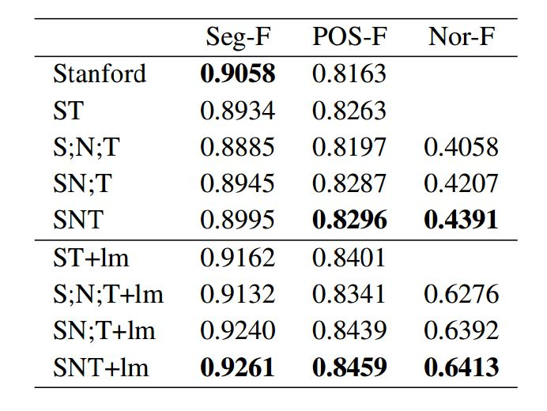
Joint Segmentation, Tagging and Normalization
Results on CTB
Tao Qian, Yue Zhang, Meishan Zhang and Donghong Ji. A Transition-based Model for Joint Segmentation, POS-tagging and Normalization. In proceedings of EMNLP 2015, Lisboa, Portugal, September.

Slide 151
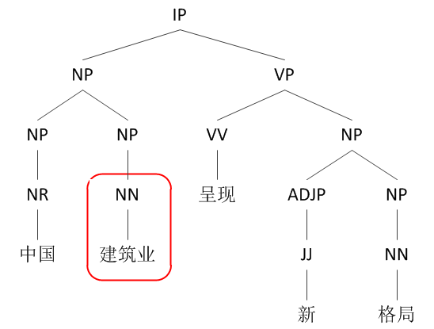
Joint Segmentation, POS-tagging and Constituent Parsing
Traditional: word-based Chinese parsing
CTB-style word-based syntax tree for “中国 (China) 建筑业 (architecture industry) 呈现 (show) 新 (new) 格局 (pattern)”.
Meishan Zhang, Yue Zhang, Wanxiang Che and Ting Liu. Chinese Parsing Exploiting Characters. In proceedings of ACL 2013. Sophia, Bulgaria. August.

Slide 152
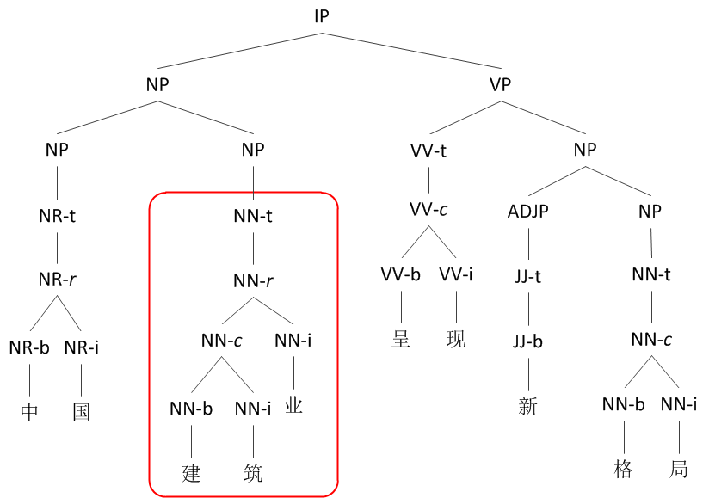
Joint Segmentation, POS-tagging and Constituent Parsing
This: character-based Chinese parsing
Character-level syntax tree with hierarchal word structures for “中 (middle) 国 (nation) 建 (construction) 筑 (building) 业 (industry) 呈 (present) 现 (show) 新 (new) 格 (style) 局 (situation)”.
Meishan Zhang, Yue Zhang, Wanxiang Che and Ting Liu. Chinese Parsing Exploiting Characters. In proceedings of ACL 2013. Sophia, Bulgaria. August.

Slide 153
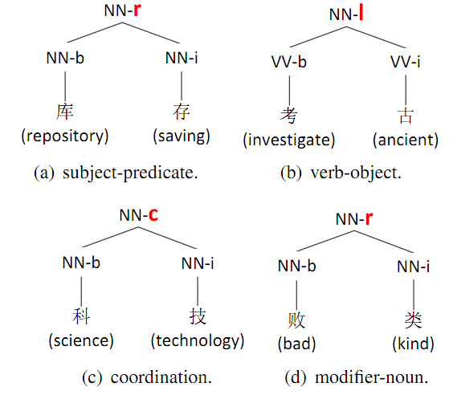
Joint Segmentation, POS-tagging and Constituent Parsing
Why character-based?
Chinese words have syntactic structures.
Meishan Zhang, Yue Zhang, Wanxiang Che and Ting Liu. Chinese Parsing Exploiting Characters. In proceedings of ACL 2013. Sophia, Bulgaria. August.

Slide 154
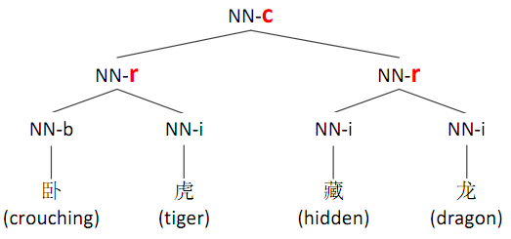
Joint Segmentation, POS-tagging and Constituent Parsing
Why character-based?
Chinese words have syntactic structures.
Meishan Zhang, Yue Zhang, Wanxiang Che and Ting Liu. Chinese Parsing Exploiting Characters. In proceedings of ACL 2013. Sophia, Bulgaria. August.

Slide 155
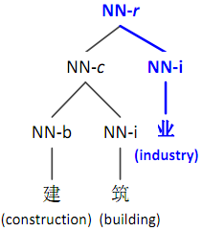
Joint Segmentation, POS-tagging and Constituent Parsing
Why character-based?
Deep character information of word structures.
Meishan Zhang, Yue Zhang, Wanxiang Che and Ting Liu. Chinese Parsing Exploiting Characters. In proceedings of ACL 2013. Sophia, Bulgaria. August.

Slide 156
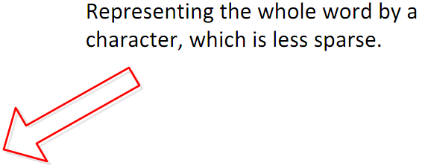
Joint Segmentation, POS-tagging and Constituent Parsing
Why character-based?
Deep character information of word structures.
Meishan Zhang, Yue Zhang, Wanxiang Che and Ting Liu. Chinese Parsing Exploiting Characters. In proceedings of ACL 2013. Sophia, Bulgaria. August.

Slide 157
Joint Segmentation, POS-tagging and Constituent Parsing
The character-based parsing model
A transition-based parser
Meishan Zhang, Yue Zhang, Wanxiang Che and Ting Liu. Chinese Parsing Exploiting Characters. In proceedings of ACL 2013. Sophia, Bulgaria. August.

Slide 158
Constituent Parsing
Transition-based Constituent Parsing
Example
SHIFT
stack
queue
DT
ADJ
NN
VV
ADJ
NNS
.
The
little
boy
likes
red
tomatoes
.
Yue Zhang and Stephen Clark. 2011. Syntactic Processing Using the Generalized Perceptron and Beam Search. In Computational Linguistics, 37(1), March.

Slide 159
Constituent Parsing
Transition-based Constituent Parsing
Example
SHIFT
stack
queue
DT
ADJ
NN
VV
ADJ
NNS
.
The
little
boy
likes
red
tomatoes
.
Yue Zhang and Stephen Clark. 2011. Syntactic Processing Using the Generalized Perceptron and Beam Search. In Computational Linguistics, 37(1), March.

Slide 160
Constituent Parsing
Transition-based Constituent Parsing
Example
SHIFT
stack
queue
DT
ADJ
NN
VV
ADJ
NNS
.
The
little
boy
likes
red
tomatoes
.
Yue Zhang and Stephen Clark. 2011. Syntactic Processing Using the Generalized Perceptron and Beam Search. In Computational Linguistics, 37(1), March.

Slide 161
Constituent Parsing
Transition-based Constituent Parsing
Example
REDUCE-R-NP
stack
queue
DT
ADJ
NN
VV
ADJ
NNS
.
The
little
boy
likes
red
tomatoes
.
Yue Zhang and Stephen Clark. 2011. Syntactic Processing Using the Generalized Perceptron and Beam Search. In Computational Linguistics, 37(1), March.

Slide 162
Constituent Parsing
Transition-based Constituent Parsing
Example
REDUCE-R-NP
stack
queue
DT
VV
ADJ
NNS
.
NP-r
The
likes
red
tomatoes
.
ADJ
NN
little
boy
Yue Zhang and Stephen Clark. 2011. Syntactic Processing Using the Generalized Perceptron and Beam Search. In Computational Linguistics, 37(1), March.

Slide 163
Constituent Parsing
Transition-based Constituent Parsing
Example
SHIFT
stack
queue
VV
ADJ
NNS
.
NP-r
likes
red
tomatoes
.
DT
NP-r
The
ADJ
NN
little
boy
Yue Zhang and Stephen Clark. 2011. Syntactic Processing Using the Generalized Perceptron and Beam Search. In Computational Linguistics, 37(1), March.

Slide 164
Constituent Parsing
Transition-based Constituent Parsing
Example
SHIFT
stack
queue
VV
ADJ
NNS
.
NP-r
likes
red
tomatoes
.
DT
NP-r
The
ADJ
NN
little
boy
Yue Zhang and Stephen Clark. 2011. Syntactic Processing Using the Generalized Perceptron and Beam Search. In Computational Linguistics, 37(1), March.

Slide 165
Constituent Parsing
Transition-based Constituent Parsing
Example
SHIFT
stack
queue
VV
ADJ
NNS
.
NP-r
likes
red
tomatoes
.
DT
NP-r
The
ADJ
NN
little
boy
Yue Zhang and Stephen Clark. 2011. Syntactic Processing Using the Generalized Perceptron and Beam Search. In Computational Linguistics, 37(1), March.

Slide 166
Constituent Parsing
Transition-based Constituent Parsing
Example
REDUCE-R-NP
stack
queue
VV
ADJ
NNS
.
NP-r
likes
red
tomatoes
.
DT
NP-r
The
ADJ
NN
little
boy
Yue Zhang and Stephen Clark. 2011. Syntactic Processing Using the Generalized Perceptron and Beam Search. In Computational Linguistics, 37(1), March.

Slide 167
Constituent Parsing
Transition-based Constituent Parsing
Example
REDUCE-L-NP
stack
queue
VV
.
NP-r
NP-r
likes
.
DT
NP-r
ADJ
NNS
The
red
tomatoes
ADJ
NN
little
boy
Yue Zhang and Stephen Clark. 2011. Syntactic Processing Using the Generalized Perceptron and Beam Search. In Computational Linguistics, 37(1), March.

Slide 168
Constituent Parsing
Transition-based Constituent Parsing
Example
SHIFT
stack
queue
.
NP-r
VP-l
.
DT
NP-r
VV
NP-r
The
likes
ADJ
NNS
ADJ
NN
little
boy
red
tomatoes
Yue Zhang and Stephen Clark. 2011. Syntactic Processing Using the Generalized Perceptron and Beam Search. In Computational Linguistics, 37(1), March.

Slide 169
Constituent Parsing
Transition-based Constituent Parsing
Example
REDUCE-L-S
stack
queue
.
NP-r
VP-l
.
DT
NP-r
VV
NP-r
The
likes
ADJ
NNS
ADJ
NN
little
boy
red
tomatoes
Yue Zhang and Stephen Clark. 2011. Syntactic Processing Using the Generalized Perceptron and Beam Search. In Computational Linguistics, 37(1), March.

Slide 170
Constituent Parsing
Transition-based Constituent Parsing
Example
REDUCE-R-S
stack
queue
NP-r
S-l
DT
NP-r
VP-l
.
The
VV
NP-r
.
ADJ
NN
little
boy
likes
ADJ
NNS
red
tomatoes
Yue Zhang and Stephen Clark. 2011. Syntactic Processing Using the Generalized Perceptron and Beam Search. In Computational Linguistics, 37(1), March.

Slide 171
Constituent Parsing
Transition-based Constituent Parsing
Example
TERMINATE
stack
queue
S-r
NP-r
S-l
DT
NP-r
VP-l
.
The
VV
NP-r
.
ADJ
NN
little
boy
likes
ADJ
NNS
red
tomatoes
Yue Zhang and Stephen Clark. 2011. Syntactic Processing Using the Generalized Perceptron and Beam Search. In Computational Linguistics, 37(1), March.

Slide 172
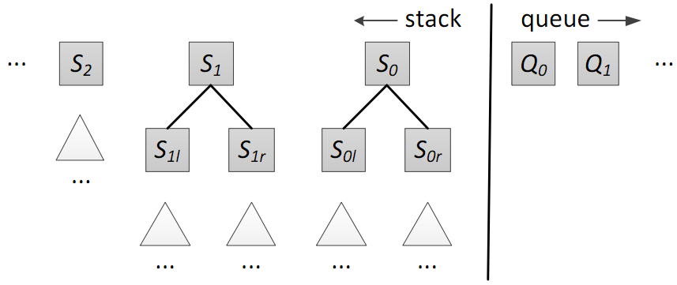
Joint Segmentation, POS-tagging and Constituent Parsing
The transition system
State:
Actions:
SHIFT-SEPARATE(t), SHIFT-APPEND, REDUCE-SUBWORD(d), REDUCE-WORD, REDUCE-BINARY(d;l), REDUCE-UNARY(l), TERMINATE
Meishan Zhang, Yue Zhang, Wanxiang Che and Ting Liu. Chinese Parsing Exploiting Characters. In proceedings of ACL 2013. Sophia, Bulgaria. August.

Slide 173
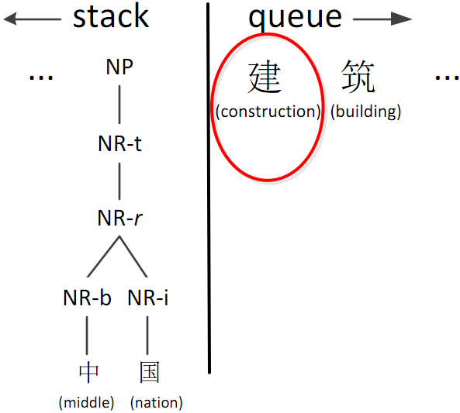
Joint Segmentation, POS-tagging and Constituent Parsing
Actions
SHIFT-SEPARATE(t)
Meishan Zhang, Yue Zhang, Wanxiang Che and Ting Liu. Chinese Parsing Exploiting Characters. In proceedings of ACL 2013. Sophia, Bulgaria. August.

Slide 174
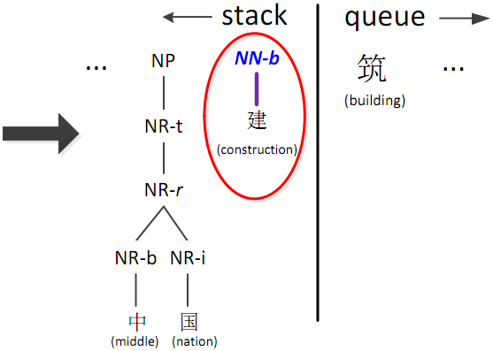
Joint Segmentation, POS-tagging and Constituent Parsing
Actions
SHIFT-SEPARATE(t)
Meishan Zhang, Yue Zhang, Wanxiang Che and Ting Liu. Chinese Parsing Exploiting Characters. In proceedings of ACL 2013. Sophia, Bulgaria. August.

Slide 175
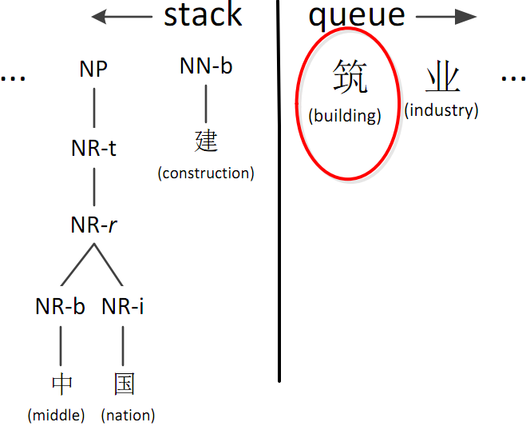
Joint Segmentation, POS-tagging and Constituent Parsing
Actions
SHIFT-APPEND
Meishan Zhang, Yue Zhang, Wanxiang Che and Ting Liu. Chinese Parsing Exploiting Characters. In proceedings of ACL 2013. Sophia, Bulgaria. August.

Slide 176
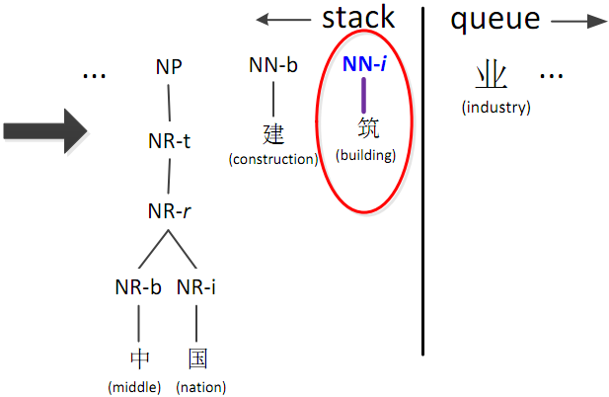
Joint Segmentation, POS-tagging and Constituent Parsing
Actions
SHIFT-APPEND
Meishan Zhang, Yue Zhang, Wanxiang Che and Ting Liu. Chinese Parsing Exploiting Characters. In proceedings of ACL 2013. Sophia, Bulgaria. August.

Slide 177
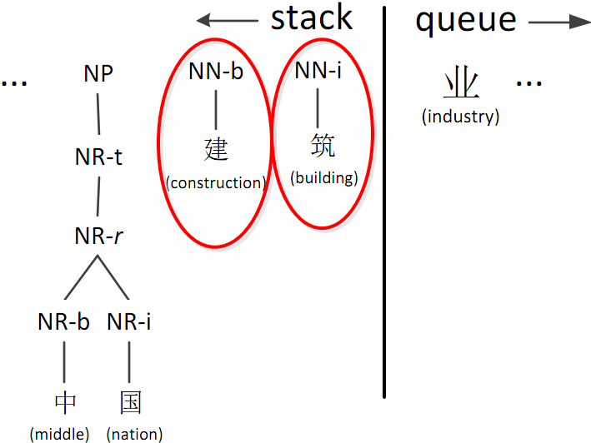
Joint Segmentation, POS-tagging and Constituent Parsing
Actions
REDUCE-SUBWORD(d)
Meishan Zhang, Yue Zhang, Wanxiang Che and Ting Liu. Chinese Parsing Exploiting Characters. In proceedings of ACL 2013. Sophia, Bulgaria. August.

Slide 178
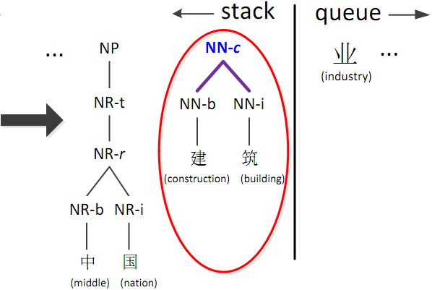
Joint Segmentation, POS-tagging and Constituent Parsing
Actions
REDUCE-SUBWORD(d)
Meishan Zhang, Yue Zhang, Wanxiang Che and Ting Liu. Chinese Parsing Exploiting Characters. In proceedings of ACL 2013. Sophia, Bulgaria. August.

Slide 179
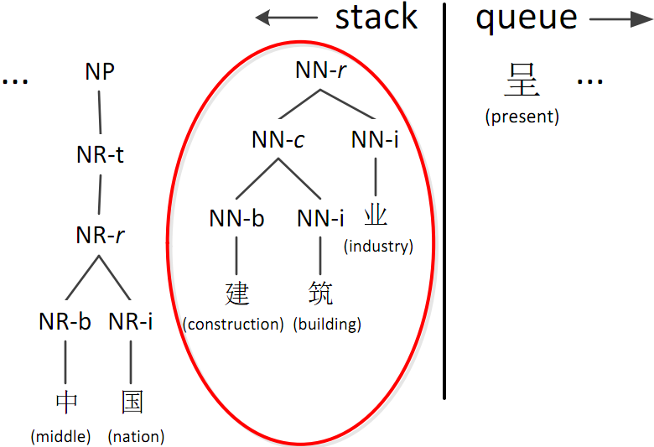
Joint Segmentation, POS-tagging and Constituent Parsing
Actions
REDUCE-WORD
Meishan Zhang, Yue Zhang, Wanxiang Che and Ting Liu. Chinese Parsing Exploiting Characters. In proceedings of ACL 2013. Sophia, Bulgaria. August.

Slide 180
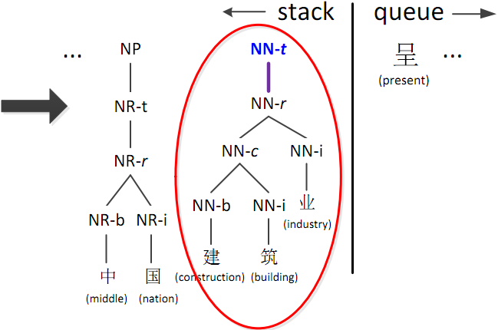
Joint Segmentation, POS-tagging and Constituent Parsing
Actions
REDUCE-WORD
Meishan Zhang, Yue Zhang, Wanxiang Che and Ting Liu. Chinese Parsing Exploiting Characters. In proceedings of ACL 2013. Sophia, Bulgaria. August.

Slide 181

Joint Segmentation, POS-tagging and Constituent Parsing
Actions
REDUCE-BINARY(d; l)
Meishan Zhang, Yue Zhang, Wanxiang Che and Ting Liu. Chinese Parsing Exploiting Characters. In proceedings of ACL 2013. Sophia, Bulgaria. August.

Slide 182

Joint Segmentation, POS-tagging and Constituent Parsing
Actions
REDUCE-BINARY(d; l)
Meishan Zhang, Yue Zhang, Wanxiang Che and Ting Liu. Chinese Parsing Exploiting Characters. In proceedings of ACL 2013. Sophia, Bulgaria. August.

Slide 183

Joint Segmentation, POS-tagging and Constituent Parsing
Actions
REDUCE-UNARY(l)
Meishan Zhang, Yue Zhang, Wanxiang Che and Ting Liu. Chinese Parsing Exploiting Characters. In proceedings of ACL 2013. Sophia, Bulgaria. August.

Slide 184

Joint Segmentation, POS-tagging and Constituent Parsing
Actions
REDUCE-UNARY(l)
Meishan Zhang, Yue Zhang, Wanxiang Che and Ting Liu. Chinese Parsing Exploiting Characters. In proceedings of ACL 2013. Sophia, Bulgaria. August.

Slide 185

Joint Segmentation, POS-tagging and Constituent Parsing
Actions
TERMINATE
Meishan Zhang, Yue Zhang, Wanxiang Che and Ting Liu. Chinese Parsing Exploiting Characters. In proceedings of ACL 2013. Sophia, Bulgaria. August.

Slide 186

Joint Segmentation, POS-tagging and Constituent Parsing
Features
Meishan Zhang, Yue Zhang, Wanxiang Che and Ting Liu. Chinese Parsing Exploiting Characters. In proceedings of ACL 2013. Sophia, Bulgaria. August.

Slide 187

Joint Segmentation, POS-tagging and Constituent Parsing
Features
Meishan Zhang, Yue Zhang, Wanxiang Che and Ting Liu. Chinese Parsing Exploiting Characters. In proceedings of ACL 2013. Sophia, Bulgaria. August.

Slide 188
Joint Segmentation, POS-tagging and Constituent Parsing
Results on CTB
Task | Seg | Tag | Parse
Kruengkrai+ ’09 | 97.87 | 93.67 | –
Sun ’11 | 98.17 | 94.02 | –
Wang+ ’11 | 98.11 | 94.18 | –
Li ’11 | 97.3 | 93.5 | 79.7
Li+ ’12 | 97.50 | 93.31 | –
Hatori+ ’12 | 98.26 | 94.64 | –
Qian+ ’12 | 97.96 | 93.81 | 82.85
Ours pipeline | 97.69 | 93.83 | 82.26
Ours joint flat | 97.73 | 94.48 | 83.61
Ours joint annotated | 97.84 | 94.80 | 84.43
Meishan Zhang, Yue Zhang, Wanxiang Che and Ting Liu. Chinese Parsing Exploiting Characters. In proceedings of ACL 2013. Sophia, Bulgaria. August.

Slide 189
Joint POS tagging and Dependency Parsing
Actions
INITIALIZATION
Stack [S]
Buffer [B]
He₁ won₂ the₃ game₄
Bohnet, Bernd, and Joakim Nivre. "A transition-based system for joint part-of-speech tagging and labeled non-projective dependency parsing." Proceedings of the 2012 Joint Conference on EMNLP and CoNLL. ACL, 2012.

Slide 190
Joint POS tagging and Dependency Parsing
Actions
SHIFT(TAG_{PRP})
Stack [S]
Buffer [B]
He_{1/PRP}
won₂ the₃ game₄
Bohnet, Bernd, and Joakim Nivre. "A transition-based system for joint part-of-speech tagging and labeled non-projective dependency parsing." Proceedings of the 2012 Joint Conference on EMNLP and CoNLL. ACL, 2012.

Slide 191
Joint POS tagging and Dependency Parsing
Actions
SHIFT(TAG_{VBD})
Stack [S]
Buffer [B]
He_{1/PRP} won_{2/VBD}
the₃ game₄
Bohnet, Bernd, and Joakim Nivre. "A transition-based system for joint part-of-speech tagging and labeled non-projective dependency parsing." Proceedings of the 2012 Joint Conference on EMNLP and CoNLL. ACL, 2012.

Slide 192
Joint POS tagging and Dependency Parsing
Actions
LEFT(LABEL_{nsubj})
Stack [S]
Buffer [B]
He_{1/PRP} won_{2/VBD}
the₃ game₄
nusbj
Bohnet, Bernd, and Joakim Nivre. "A transition-based system for joint part-of-speech tagging and labeled non-projective dependency parsing." Proceedings of the 2012 Joint Conference on EMNLP and CoNLL. ACL, 2012.

Slide 193
Joint POS tagging and Dependency Parsing
Actions
SHIFT(TAG_{DT})
Stack [S]
Buffer [B]
He_{1/PRP} won_{2/VBD} the_{3/DT}
game₄
nusbj
Bohnet, Bernd, and Joakim Nivre. "A transition-based system for joint part-of-speech tagging and labeled non-projective dependency parsing." Proceedings of the 2012 Joint Conference on EMNLP and CoNLL. ACL, 2012.

Slide 194
Joint POS tagging and Dependency Parsing
Actions
SHIFT(TAG_{NN})
Stack [S]
Buffer [B]
He_{1/PRP} won_{2/VBD} the_{3/DT} game_{4/NN}
nusbj
Bohnet, Bernd, and Joakim Nivre. "A transition-based system for joint part-of-speech tagging and labeled non-projective dependency parsing." Proceedings of the 2012 Joint Conference on EMNLP and CoNLL. ACL, 2012.

Slide 195
Joint POS tagging and Dependency Parsing
Actions
LEFT(LABEL_{det})
Stack [S]
Buffer [B]
He_{1/PRP} won_{2/VBD} the_{3/DT} game_{4/NN}
nusbj
det
Bohnet, Bernd, and Joakim Nivre. "A transition-based system for joint part-of-speech tagging and labeled non-projective dependency parsing." Proceedings of the 2012 Joint Conference on EMNLP and CoNLL. ACL, 2012.

Slide 196
Joint POS tagging and Dependency Parsing
Actions
RIGHT(LABEL_{dobj})
Stack [S]
Buffer [B]
He_{1/PRP} won_{2/VBD} the_{3/DT} game_{4/NN}
nusbj
det
dobj
Bohnet, Bernd, and Joakim Nivre. "A transition-based system for joint part-of-speech tagging and labeled non-projective dependency parsing." Proceedings of the 2012 Joint Conference on EMNLP and CoNLL. ACL, 2012.

Slide 197
Joint POS tagging and Dependency Parsing
Results
Selected entries for POS in German (benefit from joint model)
Bohnet, Bernd, and Joakim Nivre. "A transition-based system for joint part-of-speech tagging and labeled non-projective dependency parsing." Proceedings of the 2012 Joint Conference on EMNLP and CoNLL. ACL, 2012.

Slide 198

Joint Segmentation, POS-tagging and Dependency Parsing
Traditional word-based dependency parsing
Inter-word dependencies
Meishan Zhang, Yue Zhang, Wanxiang Che and Ting Liu. Character-Level Chinese Dependency Parsing. In Proceedings of ACL 2014. Baltimore, USA, June.
Jun Hatori, Takuya Matsuzaki, Yusuke Miyao, Jun’ichi Tsujii. Incremental Joint Approach to Chinese Word Segmentation, POS Tagging, and Dependency Parsing. In the Proceedings of ACL. Jeju, Korea. 2012.

Slide 199

Joint Segmentation, POS-tagging and Dependency Parsing
Character-level dependency parsing
Inter- and intra-word dependencies
Meishan Zhang, Yue Zhang, Wanxiang Che and Ting Liu. Character-Level Chinese Dependency Parsing. In Proceedings of ACL 2014. Baltimore, USA, June.
Jun Hatori, Takuya Matsuzaki, Yusuke Miyao, Jun’ichi Tsujii. Incremental Joint Approach to Chinese Word Segmentation, POS Tagging, and Dependency Parsing. In the Proceedings of ACL. Jeju, Korea. 2012.

Slide 200
Joint Segmentation, POS-tagging and Dependency Parsing
Extensions from word-level transition-based dependency parsing models
Arc-standard (Nirve 2008; Huang et al., 2009 )
Arc-eager (Nirve 2008; Zhang and Clark, 2008)
Meishan Zhang, Yue Zhang, Wanxiang Che and Ting Liu. Character-Level Chinese Dependency Parsing. In Proceedings of ACL 2014. Baltimore, USA, June.
Jun Hatori, Takuya Matsuzaki, Yusuke Miyao, Jun’ichi Tsujii. Incremental Joint Approach to Chinese Word Segmentation, POS Tagging, and Dependency Parsing. In the Proceedings of ACL. Jeju, Korea. 2012.

Slide 201

Joint Segmentation, POS-tagging and Dependency Parsing
Arc-standard
Meishan Zhang, Yue Zhang, Wanxiang Che and Ting Liu. Character-Level Chinese Dependency Parsing. In Proceedings of ACL 2014. Baltimore, USA, June.
Jun Hatori, Takuya Matsuzaki, Yusuke Miyao, Jun’ichi Tsujii. Incremental Joint Approach to Chinese Word Segmentation, POS Tagging, and Dependency Parsing. In the Proceedings of ACL. Jeju, Korea. 2012.

Slide 202


Joint Segmentation, POS-tagging and Dependency Parsing
Arc-standard
Meishan Zhang, Yue Zhang, Wanxiang Che and Ting Liu. Character-Level Chinese Dependency Parsing. In Proceedings of ACL 2014. Baltimore, USA, June.
Jun Hatori, Takuya Matsuzaki, Yusuke Miyao, Jun’ichi Tsujii. Incremental Joint Approach to Chinese Word Segmentation, POS Tagging, and Dependency Parsing. In the Proceedings of ACL. Jeju, Korea. 2012.

Slide 203

Joint Segmentation, POS-tagging and Dependency Parsing
Arc-eager
Meishan Zhang, Yue Zhang, Wanxiang Che and Ting Liu. Character-Level Chinese Dependency Parsing. In Proceedings of ACL 2014. Baltimore, USA, June.
Jun Hatori, Takuya Matsuzaki, Yusuke Miyao, Jun’ichi Tsujii. Incremental Joint Approach to Chinese Word Segmentation, POS Tagging, and Dependency Parsing. In the Proceedings of ACL. Jeju, Korea. 2012.

Slide 204


Joint Segmentation, POS-tagging and Dependency Parsing
Arc-eager
Meishan Zhang, Yue Zhang, Wanxiang Che and Ting Liu. Character-Level Chinese Dependency Parsing. In Proceedings of ACL 2014. Baltimore, USA, June.
Jun Hatori, Takuya Matsuzaki, Yusuke Miyao, Jun’ichi Tsujii. Incremental Joint Approach to Chinese Word Segmentation, POS Tagging, and Dependency Parsing. In the Proceedings of ACL. Jeju, Korea. 2012.

Slide 205



Joint Segmentation, POS-tagging and Dependency Parsing
New features
Meishan Zhang, Yue Zhang, Wanxiang Che and Ting Liu. Character-Level Chinese Dependency Parsing. In Proceedings of ACL 2014. Baltimore, USA, June.
Jun Hatori, Takuya Matsuzaki, Yusuke Miyao, Jun’ichi Tsujii. Incremental Joint Approach to Chinese Word Segmentation, POS Tagging, and Dependency Parsing. In the Proceedings of ACL. Jeju, Korea. 2012.

Slide 206

Joint Segmentation, POS-tagging and Dependency Parsing
Results on CTB
Meishan Zhang, Yue Zhang, Wanxiang Che and Ting Liu. Character-Level Chinese Dependency Parsing. In Proceedings of ACL 2014. Baltimore, USA, June.
Jun Hatori, Takuya Matsuzaki, Yusuke Miyao, Jun’ichi Tsujii. Incremental Joint Approach to Chinese Word Segmentation, POS Tagging, and Dependency Parsing. In the Proceedings of ACL. Jeju, Korea. 2012.

Slide 207
Joint Morphology and Linearization
Task
meanwhile, prices are thought to have increased.
Ratish Puduppully, Yue Zhang, Manish Shrivastava. Transition-Based Deep Input Linearization. In Proceedings of the 15th Conference of the European Chapter of the Association for Computational Linguistics (EACL). Valencia, Spain, April.

Slide 208
Joint Morphology and Linearization
Model
NLG pipeline with deep input graph
Pipeline based on the meaning text theory
This paper
Ratish Puduppully, Yue Zhang, Manish Shrivastava. Transition-Based Deep Input Linearization. In Proceedings of the 15th Conference of the European Chapter of the Association for Computational Linguistics (EACL). Valencia, Spain, April.

Slide 209
Joint Morphology and Linearization
Transition Actions
SHIFT-Word-POS [SH]
Shifts Word from ρ, as- signs POS to it and pushes it to top of stack as S₀;
LEFTARC-LABEL [LA]
Constructs dependency arc S₁ S₀ and pops out second element from top of stack S₁
RIGHTARD-LABEL [RA]
Constructs dependency arc S₁ S₀ and pops out top of stack S₀
INSERT [IN]
Inserts comma at the present position
SPLITARC-Word [SP]
splits an arc in the input graph C, inserting a function word between the words connected by the arc.
LABEL
LABEL
Ratish Puduppully, Yue Zhang, Manish Shrivastava. Transition-Based Deep Input Linearization. In Proceedings of the 15th Conference of the European Chapter of the Association for Computational Linguistics (EACL). Valencia, Spain, April.

Slide 210
Joint Morphology and Linearization
Transition Example
Sentence:
Input
Lemmas:
meanwhile, prices are thought to have increased.
think_{[1]} price_{[2]} ._{[3]} increase_{[4]} be_{[5]} have_{[6]} meanwhile_{[7]}
Ratish Puduppully, Yue Zhang, Manish Shrivastava. Transition-Based Deep Input Linearization. In Proceedings of the 15th Conference of the European Chapter of the Association for Computational Linguistics (EACL). Valencia, Spain, April.

Slide 211
Joint Morphology and Linearization
think_{[1]} price_{[2]} ._{[3]} increase_{[4]} be_{[5]} have_{[6]} meanwhile_{[7]}
Transition Action
σ
ρ
1 2 3 4 5 6 7
Ratish Puduppully, Yue Zhang, Manish Shrivastava. Transition-Based Deep Input Linearization. In Proceedings of the 15th Conference of the European Chapter of the Association for Computational Linguistics (EACL). Valencia, Spain, April.

Slide 212
Joint Morphology and Linearization
think_{[1]} price_{[2]} ._{[3]} increase_{[4]} be_{[5]} have_{[6]} meanwhile_{[7]}
Transition Action
SH-meanwhile
Meanwhile
σ
ρ
7
1 2 3 4 5 6
Ratish Puduppully, Yue Zhang, Manish Shrivastava. Transition-Based Deep Input Linearization. In Proceedings of the 15th Conference of the European Chapter of the Association for Computational Linguistics (EACL). Valencia, Spain, April.

Slide 213
Joint Morphology and Linearization
think_{[1]} price_{[2]} ._{[3]} increase_{[4]} be_{[5]} have_{[6]} meanwhile_{[7]}
Transition Action
INSERT
Meanwhile ,
σ
ρ
7
1 2 3 4 5 6
Ratish Puduppully, Yue Zhang, Manish Shrivastava. Transition-Based Deep Input Linearization. In Proceedings of the 15th Conference of the European Chapter of the Association for Computational Linguistics (EACL). Valencia, Spain, April.

Slide 214
Joint Morphology and Linearization
think_{[1]} price_{[2]} ._{[3]} increase_{[4]} be_{[5]} have_{[6]} meanwhile_{[7]}
Transition Action
SH-prices
Meanwhile , prices
σ
ρ
7 2
1 3 4 5 6
Ratish Puduppully, Yue Zhang, Manish Shrivastava. Transition-Based Deep Input Linearization. In Proceedings of the 15th Conference of the European Chapter of the Association for Computational Linguistics (EACL). Valencia, Spain, April.

Slide 215
Joint Morphology and Linearization
think_{[1]} price_{[2]} ._{[3]} increase_{[4]} be_{[5]} have_{[6]} meanwhile_{[7]}
Transition Action
SH-are
Meanwhile , prices are
σ
ρ
7 2 5
1 3 4 6
Ratish Puduppully, Yue Zhang, Manish Shrivastava. Transition-Based Deep Input Linearization. In Proceedings of the 15th Conference of the European Chapter of the Association for Computational Linguistics (EACL). Valencia, Spain, April.

Slide 216
Joint Morphology and Linearization
think_{[1]} price_{[2]} ._{[3]} increase_{[4]} be_{[5]} have_{[6]} meanwhile_{[7]}
Transition Action
SH-thought
Meanwhile , prices are thought
σ
ρ
7 2 5 1
3 4 6
Ratish Puduppully, Yue Zhang, Manish Shrivastava. Transition-Based Deep Input Linearization. In Proceedings of the 15th Conference of the European Chapter of the Association for Computational Linguistics (EACL). Valencia, Spain, April.

Slide 217
Joint Morphology and Linearization
think_{[1]} price_{[2]} ._{[3]} increase_{[4]} be_{[5]} have_{[6]} meanwhile_{[7]}
Transition Action
SH-to
Meanwhile , prices are thought to
σ
ρ
7 2 5 1
3 4 6
Ratish Puduppully, Yue Zhang, Manish Shrivastava. Transition-Based Deep Input Linearization. In Proceedings of the 15th Conference of the European Chapter of the Association for Computational Linguistics (EACL). Valencia, Spain, April.

Slide 218
Joint Morphology and Linearization
think_{[1]} price_{[2]} ._{[3]} increase_{[4]} be_{[5]} have_{[6]} meanwhile_{[7]}
Transition Action
SH-have
Meanwhile , prices are thought to have
σ
ρ
7 2 5 1 6
3 4
Ratish Puduppully, Yue Zhang, Manish Shrivastava. Transition-Based Deep Input Linearization. In Proceedings of the 15th Conference of the European Chapter of the Association for Computational Linguistics (EACL). Valencia, Spain, April.

Slide 219
Joint Morphology and Linearization
think_{[1]} price_{[2]} ._{[3]} increase_{[4]} be_{[5]} have_{[6]} meanwhile_{[7]}
Transition Action
SH-increased
Meanwhile , prices are thought to have increased
σ
ρ
7 2 5 1 6 4
3
Ratish Puduppully, Yue Zhang, Manish Shrivastava. Transition-Based Deep Input Linearization. In Proceedings of the 15th Conference of the European Chapter of the Association for Computational Linguistics (EACL). Valencia, Spain, April.

Slide 220
Joint Morphology and Linearization
think_{[1]} price_{[2]} ._{[3]} increase_{[4]} be_{[5]} have_{[6]} meanwhile_{[7]}
Transition Action
RA (6 → 4) [VC]
VC
Meanwhile , prices are thought to have increased
σ
ρ
7 2 5 1 6 4
3
Ratish Puduppully, Yue Zhang, Manish Shrivastava. Transition-Based Deep Input Linearization. In Proceedings of the 15th Conference of the European Chapter of the Association for Computational Linguistics (EACL). Valencia, Spain, April.

Slide 221
Joint Morphology and Linearization
think_{[1]} price_{[2]} ._{[3]} increase_{[4]} be_{[5]} have_{[6]} meanwhile_{[7]}
Transition Action
RA (1 → 6) [C-A1]
C-A1
VC
Meanwhile , prices are thought to have increased
σ
ρ
7 2 5 1 6
3
Ratish Puduppully, Yue Zhang, Manish Shrivastava. Transition-Based Deep Input Linearization. In Proceedings of the 15th Conference of the European Chapter of the Association for Computational Linguistics (EACL). Valencia, Spain, April.

Slide 222
Joint Morphology and Linearization
think_{[1]} price_{[2]} ._{[3]} increase_{[4]} be_{[5]} have_{[6]} meanwhile_{[7]}
Transition Action
RA (5 → 1) [VC]
VC
C-A1
VC
Meanwhile , prices are thought to have increased
σ
ρ
7 2 5 1
3
Ratish Puduppully, Yue Zhang, Manish Shrivastava. Transition-Based Deep Input Linearization. In Proceedings of the 15th Conference of the European Chapter of the Association for Computational Linguistics (EACL). Valencia, Spain, April.

Slide 223
Joint Morphology and Linearization
think_{[1]} price_{[2]} ._{[3]} increase_{[4]} be_{[5]} have_{[6]} meanwhile_{[7]}
Transition Action
SH-.
VC
C-A1
VC
Meanwhile , prices are thought to have increased .
σ
ρ
7 2 5
3
Ratish Puduppully, Yue Zhang, Manish Shrivastava. Transition-Based Deep Input Linearization. In Proceedings of the 15th Conference of the European Chapter of the Association for Computational Linguistics (EACL). Valencia, Spain, April.

Slide 224
Joint Morphology and Linearization
think_{[1]} price_{[2]} ._{[3]} increase_{[4]} be_{[5]} have_{[6]} meanwhile_{[7]}
Transition Action
RA (5 → 3) [P]
VC
C-A1
VC
Meanwhile , prices are thought to have increased .
P
σ
ρ
7 2 5 3
Ratish Puduppully, Yue Zhang, Manish Shrivastava. Transition-Based Deep Input Linearization. In Proceedings of the 15th Conference of the European Chapter of the Association for Computational Linguistics (EACL). Valencia, Spain, April.

Slide 225
Joint Morphology and Linearization
think_{[1]} price_{[2]} ._{[3]} increase_{[4]} be_{[5]} have_{[6]} meanwhile_{[7]}
Transition Action
LA (2 ← 5) [SBJ]
SBJ
VC
C-A1
VC
Meanwhile , prices are thought to have increased .
P
σ
ρ
7 2 5
Ratish Puduppully, Yue Zhang, Manish Shrivastava. Transition-Based Deep Input Linearization. In Proceedings of the 15th Conference of the European Chapter of the Association for Computational Linguistics (EACL). Valencia, Spain, April.

Slide 226
Joint Morphology and Linearization
think_{[1]} price_{[2]} ._{[3]} increase_{[4]} be_{[5]} have_{[6]} meanwhile_{[7]}
Transition Action
LA (7 ← 5) [AM-TMP]
SBJ
VC
C-A1
VC
Meanwhile , prices are thought to have increased .
AM-TMP
P
σ
ρ
5
Ratish Puduppully, Yue Zhang, Manish Shrivastava. Transition-Based Deep Input Linearization. In Proceedings of the 15th Conference of the European Chapter of the Association for Computational Linguistics (EACL). Valencia, Spain, April.

Slide 227
Joint Morphology and Linearization
Results on dataset of the Surface Realisation Shared Task
Ratish Puduppully, Yue Zhang, Manish Shrivastava. Transition-Based Deep Input Linearization. In Proceedings of the 15th Conference of the European Chapter of the Association for Computational Linguistics (EACL). Valencia, Spain, April.

Slide 228
Joint Entity and Relation Extraction
This paper investigate joint models for simultaneously extracting drugs, diseases and adverse drug events.
Gliclazide_{drug}-induced acute hepatitis_{disease}
Fei Li, Yue Zhang, Meishan Zhang and Donghong Ji. Joint Models for Extracting Adverse Drug Events from Biomedical Text. In Proceddings of IJCAI 2016. New York City, USA, July.

Slide 229
Joint Entity and Relation Extraction
We define the action as:
O, which marks the current word as not belong to either a drug or disease mention.
BC, which marks the current word as the beginning of a drug mention.
BD, which marks the current word as the beginning of a disease mention.
I, which marks the current word as part of a drug or disease mention but not the beginning.
For example
Given a sentence: Gliclazide-induced acute hepatitis.
The action sequence: “BC O O BD I O “ yields the result ”Gliclazide_{drug}-induced acute hepatitis_{disease}.”
Fei Li, Yue Zhang, Meishan Zhang and Donghong Ji. Joint Models for Extracting Adverse Drug Events from Biomedical Text. In Proceddings of IJCAI 2016. New York City, USA, July.

Slide 230
Joint Entity and Relation Extraction
The state of the joint model as a tuple <labels, disease, drugs, s ADEs>
labels is a label sequence
disease is a list of readily-recognized disease entity mentions
drugs is a list of readily-recognized drug entity mentions
ADEs is a set of ADEs
Two more actions are defined to achieve this
N, which indicates that a pair of entities does not have an ADE relation
Y, which indicates that a pair of entities has an ADE relation
Fei Li, Yue Zhang, Meishan Zhang and Donghong Ji. Joint Models for Extracting Adverse Drug Events from Biomedical Text. In Proceddings of IJCAI 2016. New York City, USA, July.

Slide 231
Joint Entity and Relation Extraction
State transition examples
Hepatitis caused by methotrexate and etretinate .
state
next action
<labels, disease, drugs, relations>
<[],[],[],[]>
BD
Fei Li, Yue Zhang, Meishan Zhang and Donghong Ji. Joint Models for Extracting Adverse Drug Events from Biomedical Text. In Proceddings of IJCAI 2016. New York City, USA, July.

Slide 232
Joint Entity and Relation Extraction
State transition examples
Hepatitis caused by methotrexate and etretinate .
BD
state
next action
<labels, disease, drugs, relations>
<[BD],[],[],[]>
O
Fei Li, Yue Zhang, Meishan Zhang and Donghong Ji. Joint Models for Extracting Adverse Drug Events from Biomedical Text. In Proceddings of IJCAI 2016. New York City, USA, July.

Slide 233
Joint Entity and Relation Extraction
State transition examples
Hepatitis caused by methotrexate and etretinate .
BD O
state
next action
<labels, disease, drugs, relations>
<[BD,O],[Hepatitis],[],[]>
O
Fei Li, Yue Zhang, Meishan Zhang and Donghong Ji. Joint Models for Extracting Adverse Drug Events from Biomedical Text. In Proceddings of IJCAI 2016. New York City, USA, July.

Slide 234
Joint Entity and Relation Extraction
State transition examples
Hepatitis caused by methotrexate and etretinate .
BD O O
state
next action
<labels, disease, drugs, relations>
<[BD,O,O],[Hepatitis],[],[]>
BC
Fei Li, Yue Zhang, Meishan Zhang and Donghong Ji. Joint Models for Extracting Adverse Drug Events from Biomedical Text. In Proceddings of IJCAI 2016. New York City, USA, July.

Slide 235
Joint Entity and Relation Extraction
State transition examples
Hepatitis caused by methotrexate and etretinate .
BD O O BC
state
next action
<labels, disease, drugs, relations>
<[BD,O,O,BC],[Hepatitis],[],[]>
O
Fei Li, Yue Zhang, Meishan Zhang and Donghong Ji. Joint Models for Extracting Adverse Drug Events from Biomedical Text. In Proceddings of IJCAI 2016. New York City, USA, July.

Slide 236
Joint Entity and Relation Extraction
State transition examples
Hepatitis caused by methotrexate and etretinate .
BD O O BC O
state
next action
<labels, disease, drugs, relations>
<[BD,O,O,BC,O],[Hepatitis],[methotrexate],[]>
Y
Fei Li, Yue Zhang, Meishan Zhang and Donghong Ji. Joint Models for Extracting Adverse Drug Events from Biomedical Text. In Proceddings of IJCAI 2016. New York City, USA, July.

Slide 237
Joint Entity and Relation Extraction
State transition examples
Hepatitis caused by methotrexate and etretinate .
BD O O BC O
state
next action
<labels, disease, drugs, relations>
<[BD,O,O,BC,O],[Hepatitis],[methotrexate],[(Hepatitis,methotrexate)]>
BC
Fei Li, Yue Zhang, Meishan Zhang and Donghong Ji. Joint Models for Extracting Adverse Drug Events from Biomedical Text. In Proceddings of IJCAI 2016. New York City, USA, July.

Slide 238
Joint Entity and Relation Extraction
State transition examples
Hepatitis caused by methotrexate and etretinate .
BD O O BC O BC
state
next action
<labels, disease, drugs, relations>
<[BD,O,O,BC,O,BC],[Hepatitis],[methotrexate],[(Hepatitis,methotrexate)]>
O
Fei Li, Yue Zhang, Meishan Zhang and Donghong Ji. Joint Models for Extracting Adverse Drug Events from Biomedical Text. In Proceddings of IJCAI 2016. New York City, USA, July.

Slide 239
Joint Entity and Relation Extraction
State transition examples
Hepatitis caused by methotrexate and etretinate .
BD O O BC O BC O
state
next action
<labels, disease, drugs, relations>
<[BD,O,O,BC,O,BC,O],[Hepatitis],[methotrexate,etretinate],[(Hepatitis,methotrexate)]>
Y
Fei Li, Yue Zhang, Meishan Zhang and Donghong Ji. Joint Models for Extracting Adverse Drug Events from Biomedical Text. In Proceddings of IJCAI 2016. New York City, USA, July.

Slide 240
Joint Entity and Relation Extraction
State transition examples
Hepatitis caused by methotrexate and etretinate .
BD O O BC O BC O
state
next action
<labels, disease, drugs, relations>
<[BD,O,O,BC,O,BC,O],[Hepatitis],[methotrexate,etretinate],[(Hepatitis,methotrexate),(Hepatitis,etretinate)]>
<EOS>
Fei Li, Yue Zhang, Meishan Zhang and Donghong Ji. Joint Models for Extracting Adverse Drug Events from Biomedical Text. In Proceddings of IJCAI 2016. New York City, USA, July.

Slide 241
Joint Entity and Relation Extraction
Perceptron learning + greedy search
Fei Li, Yue Zhang, Meishan Zhang and Donghong Ji. Joint Models for Extracting Adverse Drug Events from Biomedical Text. In Proceddings of IJCAI 2016. New York City, USA, July.

Slide 242

Joint Entity and Relation Extraction
Results on ADE data
Fei Li, Yue Zhang, Meishan Zhang and Donghong Ji. Joint Models for Extracting Adverse Drug Events from Biomedical Text. In Proceddings of IJCAI 2016. New York City, USA, July.

Slide 243
Outline
Motivation
Statistical Models
Deep Learning Models

Slide 244
Deep Learning Models
Neural Transition-based Models
Neural Graph-based Models (Multi-task Learning)
Cross Task
Cross Domain
Cross Lingual
Cross Standard

Slide 245
Deep Learning Models
Neural Transition-based Models
Neural Graph-based Models (Multi-task Learning)
Cross Task
Cross Domain
Cross Lingual
Cross Standard
Joint Search
Joint Learning

Slide 246
Joint Entity and Relation Extraction
Replacing perceptron with Neural Model.
Gliclazide_{drug}-induced acute hepatitis_{disease}
Fei Li, Yue Zhang, Meishan Zhang and Donghong Ji. Joint Models for Extracting Adverse Drug Events from Biomedical Text. In Proceddings of IJCAI 2016. New York City, USA, July.

Slide 247
Joint Entity and Relation Extraction
Model
Fei Li, Yue Zhang, Meishan Zhang and Donghong Ji. Joint Models for Extracting Adverse Drug Events from Biomedical Text. In Proceddings of IJCAI 2016. New York City, USA, July.

Slide 248
Joint Entity and Relation Extraction
Results
Fei Li, Yue Zhang, Meishan Zhang and Donghong Ji. Joint Models for Extracting Adverse Drug Events from Biomedical Text. In Proceddings of IJCAI 2016. New York City, USA, July.

Slide 249
Joint Parsing and SRL
Transition Action
all are expected to reopen soon root
Stack [S]
Buffer [M]
Queue [B]
all, are, expected, to, reopen, soon, root
Swabha Swayamdipta, Miguel Ballesteros, Chris Dyer and Noah A. Smith. Greedy, Joint Syntactic-Semantic Parsing with Stack LSTMs In proceedings of CoNLL (CoNLL 2016).

Slide 250
Joint Parsing and SRL
Transition Action
S-SHIFT
all are expected to reopen soon root
Stack [S]
Buffer [M]
Queue [B]
all
are, expected, to, reopen, soon, root
Swabha Swayamdipta, Miguel Ballesteros, Chris Dyer and Noah A. Smith. Greedy, Joint Syntactic-Semantic Parsing with Stack LSTMs In proceedings of CoNLL (CoNLL 2016).

Slide 251
Joint Parsing and SRL
Transition Action
M-SHIFT
all are expected to reopen soon root
Stack [S]
Buffer [M]
Queue [B]
all
all
are, expected, to, reopen, soon, root
Swabha Swayamdipta, Miguel Ballesteros, Chris Dyer and Noah A. Smith. Greedy, Joint Syntactic-Semantic Parsing with Stack LSTMs In proceedings of CoNLL (CoNLL 2016).

Slide 252
Joint Parsing and SRL
sbj
Transition Action
S-LEFT (sbj)
all are expected to reopen soon root
Stack [S]
Buffer [M]
Queue [B]
all
are, expected, to, reopen, soon, root
Swabha Swayamdipta, Miguel Ballesteros, Chris Dyer and Noah A. Smith. Greedy, Joint Syntactic-Semantic Parsing with Stack LSTMs In proceedings of CoNLL (CoNLL 2016).

Slide 253
Joint Parsing and SRL
sbj
Transition Action
S-SHIFT
all are expected to reopen soon root
Stack [S]
Buffer [M]
Queue [B]
are
all
are, expected, to, reopen, soon, root
Swabha Swayamdipta, Miguel Ballesteros, Chris Dyer and Noah A. Smith. Greedy, Joint Syntactic-Semantic Parsing with Stack LSTMs In proceedings of CoNLL (CoNLL 2016).

Slide 254
Joint Parsing and SRL
sbj
Transition Action
M-SHIFT
all are expected to reopen soon root
Stack [S]
Buffer [M]
Queue [B]
are
all, are
expected, to, reopen, soon, root
Swabha Swayamdipta, Miguel Ballesteros, Chris Dyer and Noah A. Smith. Greedy, Joint Syntactic-Semantic Parsing with Stack LSTMs In proceedings of CoNLL (CoNLL 2016).

Slide 255
Joint Parsing and SRL
sbj
vc
Transition Action
S-RIGHT (vc)
all are expected to reopen soon root
Stack [S]
Buffer [M]
Queue [B]
are, expected
all, are
expected, to, reopen, soon, root
Swabha Swayamdipta, Miguel Ballesteros, Chris Dyer and Noah A. Smith. Greedy, Joint Syntactic-Semantic Parsing with Stack LSTMs In proceedings of CoNLL (CoNLL 2016).

Slide 256
Joint Parsing and SRL
sbj
vc
Transition Action
M-PRED (expect.01)
all are expected to reopen soon root
Stack [S]
Buffer [M]
Queue [B]
are, expected
all, are
expected, to, reopen, soon, root
Swabha Swayamdipta, Miguel Ballesteros, Chris Dyer and Noah A. Smith. Greedy, Joint Syntactic-Semantic Parsing with Stack LSTMs In proceedings of CoNLL (CoNLL 2016).

Slide 257
Joint Parsing and SRL
sbj
vc
Transition Action
M-REDUCE
all are expected to reopen soon root
Stack [S]
Buffer [M]
Queue [B]
are, expected
all
expected, to, reopen, soon, root
Swabha Swayamdipta, Miguel Ballesteros, Chris Dyer and Noah A. Smith. Greedy, Joint Syntactic-Semantic Parsing with Stack LSTMs In proceedings of CoNLL (CoNLL 2016).

Slide 258
Joint Parsing and SRL
sbj
vc
Transition Action
M-LEFT(A1)
all are expected to reopen soon root
A1
Stack [S]
Buffer [M]
Queue [B]
are, expected
all
expected, to, reopen, soon, root
Swabha Swayamdipta, Miguel Ballesteros, Chris Dyer and Noah A. Smith. Greedy, Joint Syntactic-Semantic Parsing with Stack LSTMs In proceedings of CoNLL (CoNLL 2016).

Slide 259
Joint Parsing and SRL
sbj
vc
Transition Action
M-SHIFT
all are expected to reopen soon root
A1
Stack [S]
Buffer [M]
Queue [B]
are, expected
all, expected
to, reopen, soon, root
Swabha Swayamdipta, Miguel Ballesteros, Chris Dyer and Noah A. Smith. Greedy, Joint Syntactic-Semantic Parsing with Stack LSTMs In proceedings of CoNLL (CoNLL 2016).

Slide 260
Joint Parsing and SRL
sbj
vc
oprd
Transition Action
***S-RIGHT (oprd)
all are expected to reopen soon root
A1
Stack [S]
Buffer [M]
Queue [B]
are, expected, to
all, expected
to, reopen, soon, root
Swabha Swayamdipta, Miguel Ballesteros, Chris Dyer and Noah A. Smith. Greedy, Joint Syntactic-Semantic Parsing with Stack LSTMs In proceedings of CoNLL (CoNLL 2016).

Slide 261
Joint Parsing and SRL
sbj
vc
oprd
Transition Action
M-RIGHT (C-A1)
all are expected to reopen soon root
A1
C-A1
Stack [S]
Buffer [M]
Queue [B]
are, expected, to
all, expected
to, reopen, soon, root
Swabha Swayamdipta, Miguel Ballesteros, Chris Dyer and Noah A. Smith. Greedy, Joint Syntactic-Semantic Parsing with Stack LSTMs In proceedings of CoNLL (CoNLL 2016).

Slide 262
Joint Parsing and SRL
sbj
vc
oprd
Transition Action
M-REDUCE
all are expected to reopen soon root
A1
C-A1
Stack [S]
Buffer [M]
Queue [B]
are, expected, to
all
to, reopen, soon, root
Swabha Swayamdipta, Miguel Ballesteros, Chris Dyer and Noah A. Smith. Greedy, Joint Syntactic-Semantic Parsing with Stack LSTMs In proceedings of CoNLL (CoNLL 2016).

Slide 263
Joint Parsing and SRL
sbj
vc
oprd
Transition Action
M-SHIFT
all are expected to reopen soon root
A1
C-A1
Stack [S]
Buffer [M]
Queue [B]
are, expected, to
all, to
reopen, soon, root
Swabha Swayamdipta, Miguel Ballesteros, Chris Dyer and Noah A. Smith. Greedy, Joint Syntactic-Semantic Parsing with Stack LSTMs In proceedings of CoNLL (CoNLL 2016).

Slide 264
Joint Parsing and SRL
sbj
vc
oprd
im
Transition Action
S-RIGHT (im)
all are expected to reopen soon root
A1
C-A1
Stack [S]
Buffer [M]
Queue [B]
are, expected, to, reopen
all, to
reopen, soon, root
Swabha Swayamdipta, Miguel Ballesteros, Chris Dyer and Noah A. Smith. Greedy, Joint Syntactic-Semantic Parsing with Stack LSTMs In proceedings of CoNLL (CoNLL 2016).

Slide 265
Joint Parsing and SRL
sbj
vc
oprd
im
Transition Action
M-PRED (reopen.01)
all are expected to reopen soon root
A1
C-A1
Stack [S]
Buffer [M]
Queue [B]
are, expected, to, reopen
all, to
reopen, soon, root
Swabha Swayamdipta, Miguel Ballesteros, Chris Dyer and Noah A. Smith. Greedy, Joint Syntactic-Semantic Parsing with Stack LSTMs In proceedings of CoNLL (CoNLL 2016).

Slide 266
Joint Parsing and SRL
sbj
vc
oprd
im
Transition Action
M-REDUCE
all are expected to reopen soon root
A1
C-A1
Stack [S]
Buffer [M]
Queue [B]
are, expected, to, reopen
all
reopen, soon, root
Swabha Swayamdipta, Miguel Ballesteros, Chris Dyer and Noah A. Smith. Greedy, Joint Syntactic-Semantic Parsing with Stack LSTMs In proceedings of CoNLL (CoNLL 2016).

Slide 267
Joint Parsing and SRL
sbj
vc
oprd
im
Transition Action
M-LEFT (A1)
all are expected to reopen soon root
A1
C-A1
A1
Stack [S]
Buffer [M]
Queue [B]
are, expected, to, reopen
all
reopen, soon, root
Swabha Swayamdipta, Miguel Ballesteros, Chris Dyer and Noah A. Smith. Greedy, Joint Syntactic-Semantic Parsing with Stack LSTMs In proceedings of CoNLL (CoNLL 2016).

Slide 268
Joint Parsing and SRL
sbj
vc
oprd
im
Transition Action
M-REDUCE
all are expected to reopen soon root
A1
C-A1
A1
Stack [S]
Buffer [M]
Queue [B]
are, expected, to, reopen
reopen, soon, root
Swabha Swayamdipta, Miguel Ballesteros, Chris Dyer and Noah A. Smith. Greedy, Joint Syntactic-Semantic Parsing with Stack LSTMs In proceedings of CoNLL (CoNLL 2016).

Slide 269
Joint Parsing and SRL
sbj
vc
oprd
im
Transition Action
M-SHIFT
all are expected to reopen soon root
A1
C-A1
A1
Stack [S]
Buffer [M]
Queue [B]
are, expected, to, reopen
reopen
soon, root
Swabha Swayamdipta, Miguel Ballesteros, Chris Dyer and Noah A. Smith. Greedy, Joint Syntactic-Semantic Parsing with Stack LSTMs In proceedings of CoNLL (CoNLL 2016).

Slide 270
Joint Parsing and SRL
sbj
vc
oprd
im
tmp
Transition Action
S-RIGHT (tmp)
all are expected to reopen soon root
A1
C-A1
A1
Stack [S]
Buffer [M]
Queue [B]
are, expected, to, reopen, soon
reopen
soon, root
Swabha Swayamdipta, Miguel Ballesteros, Chris Dyer and Noah A. Smith. Greedy, Joint Syntactic-Semantic Parsing with Stack LSTMs In proceedings of CoNLL (CoNLL 2016).

Slide 271
Joint Parsing and SRL
sbj
vc
oprd
im
tmp
Transition Action
M-RIGHT (AM-TMP)
all are expected to reopen soon root
A1
C-A1
AM-TMP
A1
Stack [S]
Buffer [M]
Queue [B]
are, expected, to, reopen, soon
reopen
soon, root
Swabha Swayamdipta, Miguel Ballesteros, Chris Dyer and Noah A. Smith. Greedy, Joint Syntactic-Semantic Parsing with Stack LSTMs In proceedings of CoNLL (CoNLL 2016).

Slide 272
Joint Parsing and SRL
sbj
vc
oprd
im
tmp
Transition Action
M-REDUCE
all are expected to reopen soon root
A1
C-A1
AM-TMP
A1
Stack [S]
Buffer [M]
Queue [B]
are, expected, to, reopen, soon
soon, root
Swabha Swayamdipta, Miguel Ballesteros, Chris Dyer and Noah A. Smith. Greedy, Joint Syntactic-Semantic Parsing with Stack LSTMs In proceedings of CoNLL (CoNLL 2016).

Slide 273
Joint Parsing and SRL
sbj
vc
oprd
im
tmp
Transition Action
M-SHIFT
all are expected to reopen soon root
A1
C-A1
AM-TMP
A1
Stack [S]
Buffer [M]
Queue [B]
are, expected, to, reopen
soon
root
Swabha Swayamdipta, Miguel Ballesteros, Chris Dyer and Noah A. Smith. Greedy, Joint Syntactic-Semantic Parsing with Stack LSTMs In proceedings of CoNLL (CoNLL 2016).

Slide 274
Joint Parsing and SRL
sbj
vc
oprd
im
tmp
Transition Action
S-REDUCE
all are expected to reopen soon root
A1
C-A1
AM-TMP
A1
Stack [S]
Buffer [M]
Queue [B]
are, expected, to, reopen
soon
root
Swabha Swayamdipta, Miguel Ballesteros, Chris Dyer and Noah A. Smith. Greedy, Joint Syntactic-Semantic Parsing with Stack LSTMs In proceedings of CoNLL (CoNLL 2016).

Slide 275
Joint Parsing and SRL
sbj
vc
oprd
im
tmp
Transition Action
S-REDUCE
all are expected to reopen soon root
A1
C-A1
AM-TMP
A1
Stack [S]
Buffer [M]
Queue [B]
are, expected, to
soon
root
Swabha Swayamdipta, Miguel Ballesteros, Chris Dyer and Noah A. Smith. Greedy, Joint Syntactic-Semantic Parsing with Stack LSTMs In proceedings of CoNLL (CoNLL 2016).

Slide 276
Joint Parsing and SRL
sbj
vc
oprd
im
tmp
Transition Action
S-REDUCE
all are expected to reopen soon root
A1
C-A1
AM-TMP
A1
Stack [S]
Buffer [M]
Queue [B]
are, expected
soon
root
Swabha Swayamdipta, Miguel Ballesteros, Chris Dyer and Noah A. Smith. Greedy, Joint Syntactic-Semantic Parsing with Stack LSTMs In proceedings of CoNLL (CoNLL 2016).

Slide 277
Joint Parsing and SRL
sbj
vc
oprd
im
tmp
Transition Action
S-REDUCE
all are expected to reopen soon root
A1
C-A1
AM-TMP
A1
Stack [S]
Buffer [M]
Queue [B]
are
soon
root
Swabha Swayamdipta, Miguel Ballesteros, Chris Dyer and Noah A. Smith. Greedy, Joint Syntactic-Semantic Parsing with Stack LSTMs In proceedings of CoNLL (CoNLL 2016).

Slide 278
Joint Parsing and SRL
root
sbj
vc
oprd
im
tmp
Transition Action
S-LEFT (root)
all are expected to reopen soon root
A1
C-A1
AM-TMP
A1
Stack [S]
Buffer [M]
Queue [B]
soon
root
Swabha Swayamdipta, Miguel Ballesteros, Chris Dyer and Noah A. Smith. Greedy, Joint Syntactic-Semantic Parsing with Stack LSTMs In proceedings of CoNLL (CoNLL 2016).

Slide 279
Joint Parsing and SRL
root
sbj
vc
oprd
im
tmp
Transition Action
S-SHIFT
all are expected to reopen soon root
A1
C-A1
AM-TMP
A1
Stack [S]
Buffer [M]
Queue [B]
root
soon
root
Swabha Swayamdipta, Miguel Ballesteros, Chris Dyer and Noah A. Smith. Greedy, Joint Syntactic-Semantic Parsing with Stack LSTMs In proceedings of CoNLL (CoNLL 2016).

Slide 280
Joint Parsing and SRL
root
sbj
vc
oprd
im
tmp
Transition Action
M-REDUCE
all are expected to reopen soon root
A1
C-A1
AM-TMP
A1
Stack [S]
Buffer [M]
Queue [B]
root
root
Swabha Swayamdipta, Miguel Ballesteros, Chris Dyer and Noah A. Smith. Greedy, Joint Syntactic-Semantic Parsing with Stack LSTMs In proceedings of CoNLL (CoNLL 2016).

Slide 281
Joint Parsing and SRL
root
sbj
vc
oprd
im
tmp
Transition Action
M-SHIFT
all are expected to reopen soon root
A1
C-A1
AM-TMP
A1
Stack [S]
Buffer [M]
Queue [B]
root
root
Swabha Swayamdipta, Miguel Ballesteros, Chris Dyer and Noah A. Smith. Greedy, Joint Syntactic-Semantic Parsing with Stack LSTMs In proceedings of CoNLL (CoNLL 2016).

Slide 282
Joint Parsing and SRL
Model
Swabha Swayamdipta, Miguel Ballesteros, Chris Dyer and Noah A. Smith. Greedy, Joint Syntactic-Semantic Parsing with Stack LSTMs In proceedings of CoNLL (CoNLL 2016).

Slide 283
Joint Parsing and SRL
Results on CONLL
Swabha Swayamdipta, Miguel Ballesteros, Chris Dyer and Noah A. Smith. Greedy, Joint Syntactic-Semantic Parsing with Stack LSTMs In proceedings of CoNLL (CoNLL 2016).

Slide 284
Joint Parsing and SRL
Joint VS Pipeline
Swabha Swayamdipta, Miguel Ballesteros, Chris Dyer and Noah A. Smith. Greedy, Joint Syntactic-Semantic Parsing with Stack LSTMs In proceedings of CoNLL (CoNLL 2016).

Slide 285

Joint Word Segmentation, POS Tagging and Dependency Parsing
Model
Kurita, Shuhei, Daisuke Kawahara, and Sadao Kurohashi. "Neural Joint Model for Transition-based Chinese Syntactic Analysis." Proceedings of the 55th Annual Meeting of the Association for Computational Linguistics. Vol. 1. 2017.

Slide 286
Joint Word Segmentation, POS Tagging and Dependency Parsing
Same transition system as introduced earlier
Kurita, Shuhei, Daisuke Kawahara, and Sadao Kurohashi. "Neural Joint Model for Transition-based Chinese Syntactic Analysis." Proceedings of the 55th Annual Meeting of the Association for Computational Linguistics. Vol. 1. 2017.

Slide 287

Joint Word Segmentation, POS Tagging and Dependency Parsing
Feed-forward NN model
Kurita, Shuhei, Daisuke Kawahara, and Sadao Kurohashi. "Neural Joint Model for Transition-based Chinese Syntactic Analysis." Proceedings of the 55th Annual Meeting of the Association for Computational Linguistics. Vol. 1. 2017.

Slide 288


Joint Word Segmentation, POS Tagging and Dependency Parsing
Bi-LSTM model
Kurita, Shuhei, Daisuke Kawahara, and Sadao Kurohashi. "Neural Joint Model for Transition-based Chinese Syntactic Analysis." Proceedings of the 55th Annual Meeting of the Association for Computational Linguistics. Vol. 1. 2017.

Slide 289
Joint Word Segmentation, POS Tagging and Dependency Parsing
Results on PTB
Kurita, Shuhei, Daisuke Kawahara, and Sadao Kurohashi. "Neural Joint Model for Transition-based Chinese Syntactic Analysis." Proceedings of the 55th Annual Meeting of the Association for Computational Linguistics. Vol. 1. 2017.

Slide 290
Joint Extraction of Entities and Relations
Task
Per
Loc
Loc
John_{[1]} lives_{[2]} in_{[3]} Los_{[4]} Angeles_{[5]} California_{[6]}
Live_In
Loc_In
Live_In
Shaolei Wang, Yue Zhang, Wanxiang Che, Ting Liu. 2018. Joint Extraction of Entities and Relations Based on a Novel Graph Scheme. In Proceedings of 27th IJCAI-ECAI

Slide 291
Joint Extraction of Entities and Relations
Transition Actions
Initialization
John_{[1]} lives_{[2]} in_{[3]} Los_{[4]} Angeles_{[5]} California_{[6]}
σ
δ
e
β
1, . . . , 6
Shaolei Wang, Yue Zhang, Wanxiang Che, Ting Liu. 2018. Joint Extraction of Entities and Relations Based on a Novel Graph Scheme. In Proceedings of 27th IJCAI-ECAI

Slide 292
Joint Extraction of Entities and Relations
Transition Actions
NER-SHIFT
John_{[1]} lives_{[2]} in_{[3]} Los_{[4]} Angeles_{[5]} California_{[6]}
σ
δ
e
β
1
2, . . . , 6
Shaolei Wang, Yue Zhang, Wanxiang Che, Ting Liu. 2018. Joint Extraction of Entities and Relations Based on a Novel Graph Scheme. In Proceedings of 27th IJCAI-ECAI

Slide 293
Joint Extraction of Entities and Relations
Transition Actions
NER-PER
Per
John_{[1]} lives_{[2]} in_{[3]} Los_{[4]} Angeles_{[5]} California_{[6]}
σ
δ
e
β
1*, . . . , 6
Shaolei Wang, Yue Zhang, Wanxiang Che, Ting Liu. 2018. Joint Extraction of Entities and Relations Based on a Novel Graph Scheme. In Proceedings of 27th IJCAI-ECAI

Slide 294
Joint Extraction of Entities and Relations
Transition Actions
NO-SHIFT
Per
John_{[1]} lives_{[2]} in_{[3]} Los_{[4]} Angeles_{[5]} California_{[6]}
σ
δ
e
β
1*
2, . . . , 6
Shaolei Wang, Yue Zhang, Wanxiang Che, Ting Liu. 2018. Joint Extraction of Entities and Relations Based on a Novel Graph Scheme. In Proceedings of 27th IJCAI-ECAI

Slide 295
Joint Extraction of Entities and Relations
Transition Actions
O-DELETE
Per
John_{[1]} lives_{[2]} in_{[3]} Los_{[4]} Angeles_{[5]} California_{[6]}
σ
δ
e
β
1*
3, . . . , 6
Shaolei Wang, Yue Zhang, Wanxiang Che, Ting Liu. 2018. Joint Extraction of Entities and Relations Based on a Novel Graph Scheme. In Proceedings of 27th IJCAI-ECAI

Slide 296
Joint Extraction of Entities and Relations
Transition Actions
O-DELETE
Per
John_{[1]} lives_{[2]} in_{[3]} Los_{[4]} Angeles_{[5]} California_{[6]}
σ
δ
e
β
1*
4, . . . , 6
Shaolei Wang, Yue Zhang, Wanxiang Che, Ting Liu. 2018. Joint Extraction of Entities and Relations Based on a Novel Graph Scheme. In Proceedings of 27th IJCAI-ECAI

Slide 297
Joint Extraction of Entities and Relations
Transition Actions
NER-SHIFT
Per
John_{[1]} lives_{[2]} in_{[3]} Los_{[4]} Angeles_{[5]} California_{[6]}
σ
δ
e
β
1*
4
5 , 6
Shaolei Wang, Yue Zhang, Wanxiang Che, Ting Liu. 2018. Joint Extraction of Entities and Relations Based on a Novel Graph Scheme. In Proceedings of 27th IJCAI-ECAI

Slide 298
Joint Extraction of Entities and Relations
Transition Actions
NER-SHIFT
Per
John_{[1]} lives_{[2]} in_{[3]} Los_{[4]} Angeles_{[5]} California_{[6]}
σ
δ
e
β
1*
4, 5
6
Shaolei Wang, Yue Zhang, Wanxiang Che, Ting Liu. 2018. Joint Extraction of Entities and Relations Based on a Novel Graph Scheme. In Proceedings of 27th IJCAI-ECAI

Slide 299
Joint Extraction of Entities and Relations
Transition Actions
NER-LOC
Per
Loc
John_{[1]} lives_{[2]} in_{[3]} Los_{[4]} Angeles_{[5]} California_{[6]}
σ
δ
e
β
1*
5*, 6
Shaolei Wang, Yue Zhang, Wanxiang Che, Ting Liu. 2018. Joint Extraction of Entities and Relations Based on a Novel Graph Scheme. In Proceedings of 27th IJCAI-ECAI

Slide 300
Joint Extraction of Entities and Relations
Transition Actions
RIGHT-SHIFT(Live_In)
Per
Loc
John_{[1]} lives_{[2]} in_{[3]} Los_{[4]} Angeles_{[5]} California_{[6]}
Live_In
σ
δ
e
β
1*, 5*
6
Shaolei Wang, Yue Zhang, Wanxiang Che, Ting Liu. 2018. Joint Extraction of Entities and Relations Based on a Novel Graph Scheme. In Proceedings of 27th IJCAI-ECAI

Slide 301
Joint Extraction of Entities and Relations
Transition Actions
NER-SHIFT
Per
Loc
John_{[1]} lives_{[2]} in_{[3]} Los_{[4]} Angeles_{[5]} California_{[6]}
Live_In
σ
δ
e
β
1*, 5*
6
Shaolei Wang, Yue Zhang, Wanxiang Che, Ting Liu. 2018. Joint Extraction of Entities and Relations Based on a Novel Graph Scheme. In Proceedings of 27th IJCAI-ECAI

Slide 302
Joint Extraction of Entities and Relations
Transition Actions
NER-LOC
Per
Loc
Loc
John_{[1]} lives_{[2]} in_{[3]} Los_{[4]} Angeles_{[5]} California_{[6]}
Live_In
σ
δ
e
β
1*, 5*
6*
Shaolei Wang, Yue Zhang, Wanxiang Che, Ting Liu. 2018. Joint Extraction of Entities and Relations Based on a Novel Graph Scheme. In Proceedings of 27th IJCAI-ECAI

Slide 303
Joint Extraction of Entities and Relations
Transition Actions
RIGHT-PASS(Loc_In)
Per
Loc
Loc
John_{[1]} lives_{[2]} in_{[3]} Los_{[4]} Angeles_{[5]} California_{[6]}
Live_In
Loc_In
σ
δ
e
β
1*
5*
6*
Shaolei Wang, Yue Zhang, Wanxiang Che, Ting Liu. 2018. Joint Extraction of Entities and Relations Based on a Novel Graph Scheme. In Proceedings of 27th IJCAI-ECAI

Slide 304
Joint Extraction of Entities and Relations
Transition Actions
RIGHT-SHIFT(Live_In)
Per
Loc
Loc
John_{[1]} lives_{[2]} in_{[3]} Los_{[4]} Angeles_{[5]} California_{[6]}
Live_In
Loc_In
Live_In
σ
δ
e
β
1*, 5*, 6*
Shaolei Wang, Yue Zhang, Wanxiang Che, Ting Liu. 2018. Joint Extraction of Entities and Relations Based on a Novel Graph Scheme. In Proceedings of 27th IJCAI-ECAI

Slide 305
Joint Extraction of Entities and Relations
Model
Shaolei Wang, Yue Zhang, Wanxiang Che, Ting Liu. 2018. Joint Extraction of Entities and Relations Based on a Novel Graph Scheme. In Proceedings of 27th IJCAI-ECAI

Slide 306
Joint Extraction of Entities and Relations
Results on NYT
Shaolei Wang, Yue Zhang, Wanxiang Che, Ting Liu. 2018. Joint Extraction of Entities and Relations Based on a Novel Graph Scheme. In Proceedings of 27th IJCAI-ECAI

Slide 307
Deep Learning Models
Neural Transition-based Models
Neural Graph-based Models (Multi-task Learning)
Cross Task
Cross Lingual
Cross Domain
Cross Standard

Slide 308
Deep Learning Models
Neural Transition-based Models
Neural Graph-based Models (Multi-task Learning)
Cross Task
Cross Lingual
Cross Domain
Cross Standard
Separate Search
Joint Learning

Slide 309
Neural Graph-based Models (Multi-task Learning)
Output 1
Output 2
......
Output n
Task 1
Task 2
......
Task n
Shared parameters
Input

Slide 310
Neural Graph-based Models (Multi-task Learning)
Cross Task
Cross Lingual
Cross Domain
Cross Standard

Slide 311
Neural Graph-based Models (Multi-task Learning)
Cross Task
Cross Lingual
Cross Domain
Cross Standard

Slide 312

Joint Tagging, Chunking and NER
Seminal work in NLP
Collobert, Ronan, et al. "Natural language processing (almost) from scratch." Journal of Machine Learning Research 12.Aug (2011): 2493-2537.

Slide 313

Joint Tagging, Chunking and NER
Multitasking between Tagging, Chunking and NER
Share lookup table
Share first linear layers
Collobert, Ronan, et al. "Natural language processing (almost) from scratch." Journal of Machine Learning Research 12.Aug (2011): 2493-2537.

Slide 314

Joint Tagging, Chunking and NER
Results
Collobert, Ronan, et al. "Natural language processing (almost) from scratch." Journal of Machine Learning Research 12.Aug (2011): 2493-2537.

Slide 315
NER and Language Modelling
Model
Rei, Marek. “Semi-supervised Multitask Learning for Sequence Labeling.”, In proceedings of ACL (2017).

Slide 316
NER and Language Modelling
Results
Rei, Marek. “Semi-supervised Multitask Learning for Sequence Labeling.”, In proceedings of ACL (2017).

Slide 317
Joint POS tagging/Chunking and CCG Super Tagging
Model
Chunking
CCG lexical categories
Bi-RNN
Bi-RNN
POS tagging
Bi-RNN
Inputs
Søgaard, Anders, and Yoav Goldberg. "Deep multi-task learning with low level tasks supervised at lower layers." Proceedings of the 54th Annual Meeting of the Association for Computational Linguistics (Volume 2: Short Papers). Vol. 2. 2016.

Slide 318
Joint POS tagging/Chunking and CCG Super Tagging
Results
Additional tasks such as NER do not benefit from multi-task learning
Søgaard, Anders, and Yoav Goldberg. "Deep multi-task learning with low level tasks supervised at lower layers." Proceedings of the 54th Annual Meeting of the Association for Computational Linguistics (Volume 2: Short Papers). Vol. 2. 2016.

Slide 319
Joint Parsing and SRL
Share only the embedding layer
Syntax
Semantic Roles
Parser
SRL
Input
Peng Shi, Zhiyang Teng and Yue Zhang. Exploiting Mutual Benefits between Syntax and Semantic Roles using Neural Network. In Proceeddings of EMNLP 2016.

Slide 320
Joint Parsing and SRL
Results on CONLL
Sharing more layers have mixed results
Peng Shi, Zhiyang Teng and Yue Zhang. Exploiting Mutual Benefits between Syntax and Semantic Roles using Neural Network. In Proceeddings of EMNLP 2016.
Peng Shi and Yue Zhang, Joint Bi-Affine Parsing and Semantic Role Labeling, IALP 2017, Best Paper

Slide 321
Joint Frame Semantic and Constituent Parsing
FrameNet lexicon
Swayamdipta, S., Thomson, S., Dyer, C., & Smith, N. A. (2017). Frame-semantic parsing with softmax-margin segmental RNNs and a syntactic scaffold. arXiv preprint arXiv:1706.09528.

Slide 322
Joint Frame Semantic and Constituent Parsing
Standard Multi-task
Frame Semantics
Constituent Parsing
NN
Inputs
Swayamdipta, S., Thomson, S., Dyer, C., & Smith, N. A. (2017). Frame-semantic parsing with softmax-margin segmental RNNs and a syntactic scaffold. arXiv preprint arXiv:1706.09528.

Slide 323
Joint Frame Semantic and Constituent Parsing
Results on FrameNet (September 2010 release)
Swayamdipta, S., Thomson, S., Dyer, C., & Smith, N. A. (2017). Frame-semantic parsing with softmax-margin segmental RNNs and a syntactic scaffold. arXiv preprint arXiv:1706.09528.

Slide 324

Joint Entity and Relation Extraction
Miwa, Makoto, and Mohit Bansal. “End-to-end relation extraction using lstms on sequences and tree structures.” In proceedings of ACL (2016).
Relation Extraction

Slide 325

Joint Entity and Relation Extraction
Miwa, Makoto, and Mohit Bansal. “End-to-end relation extraction using lstms on sequences and tree structures.” In proceedings of ACL (2016).
Table-Filling

Slide 326
Joint Entity and Relation Extraction
Miwa, Makoto, and Mohit Bansal. “End-to-end relation extraction using lstms on sequences and tree structures.” In proceedings of ACL (2016).
Share RNN hidden layers

Slide 327
Joint Entity and Relation Extraction
Miwa, Makoto, and Mohit Bansal. “End-to-end relation extraction using lstms on sequences and tree structures.” In proceedings of ACL (2016).
Results on ACE

Slide 328
Joint Entity and Relation Extraction
Zhang, Meishan, et al. "End-to-End Neural Relation Extraction with Global Optimization." EMNLP, 2017.
Beam Search with Global Learning
Syntactic Features by sharing the last hidden layer of (Dozat and Mining, 2017)

Slide 329

Joint Entity and Relation Extraction
Share RNN Encoding Layers
12 features
Zhang, Meishan, et al. "End-to-End Neural Relation Extraction with Global Optimization." EMNLP, 2017.

Slide 330

Joint Entity and Relation Extraction
Results on ACE05
Zhang, Meishan, et al. "End-to-End Neural Relation Extraction with Global Optimization." EMNLP, 2017.

Slide 331
Keystroke and Shallow Syntactic Parsing
Keystroke Logging
Aggregate statistics
Barbara Plank. Keystroke dynamics as signal for shallow syntactic parsing. The 26th International Conference on Computational Linguistics (COLING). Osaka, Japan.

Slide 332
Keystroke and Shallow Syntactic Parsing
Model
Barbara Plank. Keystroke dynamics as signal for shallow syntactic parsing. The 26th International Conference on Computational Linguistics (COLING). Osaka, Japan.

Slide 333
Keystroke and Shallow Syntactic Parsing
Results
Chunking and CCG data
Barbara Plank. Keystroke dynamics as signal for shallow syntactic parsing. The 26th International Conference on Computational Linguistics (COLING). Osaka, Japan.

Slide 334
RST Discourse Parser
Many tasks
Main task
Other views
Other tasks
Braud, Chloé, Barbara Plank, and Anders Søgaard. "Multi-view and multi-task training of RST discourse parsers." Proceedings of COLING 2016, the 26th International Conference on Computational Linguistics: Technical Papers. 2016.

Slide 335
RST Discourse Parser
Results on RST Discourse Treebank
Braud, Chloé, Barbara Plank, and Anders Søgaard. "Multi-view and multi-task training of RST discourse parsers." Proceedings of COLING 2016, the 26th International Conference on Computational Linguistics: Technical Papers. 2016.

Slide 336
Joint Entity and Sentiment Extraction
Zhang, Meishan, Yue Zhang, and Duy-Tin Vo. "Neural Networks for Open Domain Targeted Sentiment." EMNLP. 2015.

Slide 337

Joint Entity and Sentiment Extraction
Pipeline
Zhang, Meishan, Yue Zhang, and Duy-Tin Vo. "Neural Networks for Open Domain Targeted Sentiment." EMNLP. 2015.

Slide 338

Joint Entity and Sentiment Extraction
Joint
Zhang, Meishan, Yue Zhang, and Duy-Tin Vo. "Neural Networks for Open Domain Targeted Sentiment." EMNLP. 2015.

Slide 339

Joint Entity and Sentiment Extraction
Collapsed
Zhang, Meishan, Yue Zhang, and Duy-Tin Vo. "Neural Networks for Open Domain Targeted Sentiment." EMNLP. 2015.

Slide 340

Joint Entity and Sentiment Extraction
Results
Zhang, Meishan, Yue Zhang, and Duy-Tin Vo. "Neural Networks for Open Domain Targeted Sentiment." EMNLP. 2015.

Slide 341
Identifying beneficial task relations
Not all tasks are mutually beneficial !
CCG Tagging
Chunking
Sentence Compression
Semantic frames
POS tagging
Hyperlink Prediction
Keyphrase Detection
MWE Detection
Super-sense Tagging
Bingel, Joachim, and Anders Søgaard. "Identifying beneficial task relations for multi-task learning in deep neural networks." arXiv preprint arXiv:1702.08303 (2017).
Hector Mart ´ ´ınez Alonso and Barbara Plank. 2017. Multitask learning for semantic sequence prediction under varying data conditions. In EACL.
Mou, Lili, et al. "How transferable are neural networks in nlp applications?." arXiv preprint arXiv:1603.06111 (2016).

Slide 342
Pre-training

Slide 343

Word Segmentation
Rich Multi-task pretraining of character window representations
Jie Yang, Yue Zhang, Fei Dong. Neural Word Segmentation with Rich Pretraining. In Proceedings of the 55th Annual Meeting of the Association for Computational Linguistics (2017)

Slide 344
Word Segmentation
Results
Jie Yang, Yue Zhang, Fei Dong. Neural Word Segmentation with Rich Pretraining. In Proceedings of the 55th Annual Meeting of the Association for Computational Linguistics (2017)

Slide 345
Word Segmentation
Results
Jie Yang, Yue Zhang, Fei Dong. Neural Word Segmentation with Rich Pretraining. In Proceedings of the 55th Annual Meeting of the Association for Computational Linguistics (2017)

Slide 346

Language Translation and Language Modelling
Language Model Pretrain for both the source and target
Ramachandran, Prajit, Peter J. Liu, and Quoc V. Le. “Unsupervised pretraining for sequence to sequence learning.” In Proceeddings of EMNLP, (2016).

Slide 347
Language Translation and Language Modelling
Results on WMT
Ramachandran, Prajit, Peter J. Liu, and Quoc V. Le. “Unsupervised pretraining for sequence to sequence learning.” In Proceeddings of EMNLP, (2016).

Slide 348
Language Model Pretraining
Embeddings from Language Models (ELMo)
Peters, Matthew E., et al. "Deep contextualized word representations." arXiv preprint arXiv:1802.05365 (2018).

Slide 349
Language Model Pretraining
Results
Peters, Matthew E., et al. "Deep contextualized word representations." arXiv preprint arXiv:1802.05365 (2018).

Slide 350
Neural Graph-based Models (Multi-task Learning)
Cross Task
Cross Lingual
Cross Domain
Cross Standard

Slide 351
Multi-lingual Neural Transliteration
Orthographically similar languages
(i) highly overlapping phoneme sets.
(ii) mutually compatible orthographic systems.
(iii) similar grapheme to phoneme mappings.
Kunchukuttan, Anoop, et al. "Leveraging Orthographic Similarity for Multilingual Neural Transliteration." Transactions of the Association for Computational Linguistics 6 (2018): 303-316.

Slide 352
Multi-lingual Neural Transliteration
Standard multi-task
Kunchukuttan, Anoop, et al. "Leveraging Orthographic Similarity for Multilingual Neural Transliteration." Transactions of the Association for Computational Linguistics 6 (2018): 303-316.

Slide 353
Multi-lingual Neural Transliteration
Results on NEWS 2015
Comparison of bilingual (B) and multilingual (M) neural models as well as bilingual PBSMT (P) models (top-1 accuracy %). Figure in brackets for each dataset shows average increase in transliteration accuracy for multilingual neural model over bilingual neural model. Best accuracies for each language pair in bold.
Kunchukuttan, Anoop, et al. "Leveraging Orthographic Similarity for Multilingual Neural Transliteration." Transactions of the Association for Computational Linguistics 6 (2018): 303-316.

Slide 354
Low resource dependency parsing
Transferred Parameters
Duong, Long, et al. "Low resource dependency parsing: Cross-lingual parameter sharing in a neural network parser." Proceedings of the 53rd Annual Meeting of the Association for Computational Linguistics and the 7th International Joint Conference on Natural Language Processing (Volume 2: Short Papers). Vol. 2. 2015.

Slide 355
Low resource dependency parsing
“ To allow parameter sharing between languages we could jointly train the parser on the source and target language simultaneously. However, we leave this for future work. First we train a lexicalized neural network parser on the source resource-rich language (English), as described in Section 2. "
Duong, Long, et al. "Low resource dependency parsing: Cross-lingual parameter sharing in a neural network parser." Proceedings of the 53rd Annual Meeting of the Association for Computational Linguistics and the 7th International Joint Conference on Natural Language Processing (Volume 2: Short Papers). Vol. 2. 2015.

Slide 356
Low resource dependency parsing
Results
Save human label effort
Duong, Long, et al. "Low resource dependency parsing: Cross-lingual parameter sharing in a neural network parser." Proceedings of the 53rd Annual Meeting of the Association for Computational Linguistics and the 7th International Joint Conference on Natural Language Processing (Volume 2: Short Papers). Vol. 2. 2015.

Slide 357
Multi-lingual parser
‘Future Work’ mentioned in the previous work.
Seven languages jointly trained
Words: Cross-lingual embeddings and cross-lingual word cluster
Languages: Language embeddings!
Ammar, Waleed, et al. "Many languages, one parser." arXiv preprint arXiv:1602.01595 (2016).

Slide 358
Multi-lingual parser
Results on UD Treebank
Ammar, Waleed, et al. "Many languages, one parser." arXiv preprint arXiv:1602.01595 (2016).

Slide 359

Singlish Parsing
Variation on Parameter
Sharing
Hongmin Wang, Yue Zhang, GuangYong Leonard Chan, Jie Yang, Hai Leong Chieu. Universal Dependencies Parsing for Colloquial Singaporean English. In Proceedings of the 55th Annual Meeting of the Association for Computational Linguistics (ACL). Vancouver, Canada, July.

Slide 360
Singlish Parsing
Results
POS tagging
Dependency Parsing
Hongmin Wang, Yue Zhang, GuangYong Leonard Chan, Jie Yang, Hai Leong Chieu. Universal Dependencies Parsing for Colloquial Singaporean English. In Proceedings of the 55th Annual Meeting of the Association for Computational Linguistics (ACL). Vancouver, Canada, July.

Slide 361
Low resource neural machine translation
Variation on model structure: Rich Resource(EN→ FR) pretraining, low resource (EN → UZ) fine-tuning
Zoph, Barret, et al. "Transfer learning for low-resource neural machine translation." In Proceeddings of EMNLP, (2016).

Slide 362
Low resource neural machine translation
Results
Zoph, Barret, et al. "Transfer learning for low-resource neural machine translation." In Proceeddings of EMNLP, (2016).

Slide 363

Cross-lingual
Adversarial training
Language model auxiliary
task
Kim, Joo-Kyung, et al. "Cross-Lingual Transfer Learning for POS Tagging without Cross-Lingual Resources." Proceedings of the 2017 Conference on Empirical Methods in Natural Language Processing. 2017.

Slide 364
Cross-lingual
Results on UD treebank
Kim, Joo-Kyung, et al. "Cross-Lingual Transfer Learning for POS Tagging without Cross-Lingual Resources." Proceedings of the 2017 Conference on Empirical Methods in Natural Language Processing. 2017.

Slide 365
Neural Graph-based Models (Multi-task Learning)
Cross Task
Cross Lingual
Cross Domain
Cross Standard

Slide 366

Sequence Tagging
Standard Multi-task
Yang, Zhilin, Ruslan Salakhutdinov, and William W. Cohen. "Transfer learning for sequence tagging with hierarchical recurrent networks." ICLR. 2017.

Slide 367
Sequence Tagging
Results
Yang, Zhilin, Ruslan Salakhutdinov, and William W. Cohen. "Transfer learning for sequence tagging with hierarchical recurrent networks." ICLR. 2017.

Slide 368
Chinese Word Segmentation
Adversarial training
Xinchi Chen, Zhan Shi, Xipeng Qiu, Xuanjing Huang. Adversarial Multi-Criteria Learning for Chinese Word Segmentation, ACL, 2017.

Slide 369
Chinese Word Segmentation
Results
Xinchi Chen, Zhan Shi, Xipeng Qiu, Xuanjing Huang. Adversarial Multi-Criteria Learning for Chinese Word Segmentation, ACL, 2017.

Slide 370
Multi-domain Sentiment Classification
Adversarial training
Domain Embeddings
Memory Network
Qi Liu, Yue Zhang, Jiangming Liu, 2018. Learning Domain Representation for Multi-domain Sentiment Classification. In Proceedings of 16th Annual Conference of the North American Chapter of the Association for Computational Linguistics (NAACL), New Orleans, Louisiana, June.

Slide 371
Multi-domain Sentiment Classification
Results
Qi Liu, Yue Zhang, Jiangming Liu, 2018. Learning Domain Representation for Multi-domain Sentiment Classification. In Proceedings of 16th Annual Conference of the North American Chapter of the Association for Computational Linguistics (NAACL), New Orleans, Louisiana, June.

Slide 372
Neural Graph-based Models (Multi-task Learning)
Cross Task
Cross Lingual
Cross Domain
Cross Standard

Slide 373
POS tagging
Same language, different standard
中国 | 最大 | 氨纶丝 | 生产 | 基地 | 在 | 连云港 | 建成 | 。
NR | JJ | NN | NN | NN | P | NR | VV | PU
CTB:
第四 | 条 | 防震 | 减灾 | 工作 | ， | 应当 | 纳入 | 国民经济 | 和 | 社会 | 发展 | 计划 | 。
m | q | vn | vn | vn | w | v | v | n | c | n | vn | n | w
PD:
Chen, Hongshen, Yue Zhang, and Qun Liu. "Neural Network for Heterogeneous Annotations." EMNLP. 2016.

Slide 374

POS tagging
Standard neural multi-view model
Chen, Hongshen, Yue Zhang, and Qun Liu. "Neural Network for Heterogeneous Annotations." EMNLP. 2016.

Slide 375
POS tagging
Results
Chen, Hongshen, Yue Zhang, and Qun Liu. "Neural Network for Heterogeneous Annotations." EMNLP. 2016.

Slide 376
Dependency parsing
Same language with multiple treebanks
Treebank embeddings
Treebank 1
Treebank 2
. . . .
Treebank n
Model
Word Embeddings
Treebank embeddings
Stymne, Sara, et al. "Parser Training with Heterogeneous Treebanks." arXiv preprint arXiv:1805.05089 (2018).

Slide 377
Dependency parsing
Results
Stymne, Sara, et al. "Parser Training with Heterogeneous Treebanks." arXiv preprint arXiv:1805.05089 (2018).

Slide 378
Thanks!

